Slide 1


PROJECT REPORT ON
NETWORK MANAGEMENT
Under Supervision-
Santu Purkait
(Director)
Netcamp Solution Private Limited
9331090003
santu@netcamp.in
www.netcamp.in
SUBMITTED BY
ANANT GUPTA
SHRI RAMSWAROOP MEMORIAL COLLEGE OF ENGINEERING AND MANAGEMENT

Slide 2
ACKNOWLEDGEMENT
I have taken efforts in this project. However, it would not have been possible without the kind support and help of many individuals and organization. I would like to extend my sincere thanks to all of them.
I am highly indebted to Netcamp Solutions Pvt.. Ltd. For their guidance and constant supervision as well as for their support in completing the project.
I would like to express my gratitude towards Mr.Santu Purkait, Director, Netcamp Solutions Pvt Ltd. For their kind co-operation and encouragement which help me in completion of this project.
I would like to express my special gratitude and thanks to the organization person for giving me such attention and time.
My thanks and appreciation also go to my colleagues in developing the project and people who have willingly helped me out with their abilities.
NAME:
ROLL NO:
COLLEGE:
SIGNATURE:
DATE:
ANANT GUPTA
1901220130020
SHRI RAMSWAROOP MEMORIAL COLLEGE OF ENGINEERING AND MANAGEMENT
15 JUNE 2021

Slide 3
NETCAMP SOLUTIONS PRIVATE LIMITED
CERTIFICATE
This is to certify that, Anant Gupta, a student of program,
Network Management has successfully completed a project
On Network Management under the guidance of Mr. Santu Purkait during the dates: 15 May 2021 - 15 July 2021 by Netcamp Solutions Private Limited.

Slide 4
TOPICS | PAGE NO
1 PROBLEM STATEMENT ( PS ) | 5
1 SERVER | 10
2 WEBMIN | 13
3 DOMAINS | 14
4 MAIL SERVER | 18
5 HOSTING | 19
6 TELNET | 20
7 DHCP CONFIGURATION | 23
8 SENDMAIL CONFIGURATION | 29
9 CREATING USER | 34
10 SAMBA SHARE | 36
11 DOVECOT IMAP/POP3 | 44
12 NETWORK CONFIG | 46
13 PARTITION & QUOTAS | 49
14 FIREWALL | 55
15 LINUX SHARE ON WINDWS | 57
16 CHANGING LOGO | 65
TOPICS | PAGE NUMBER
1.

Slide 5
PROBLEM STATEMENT ( PS)
Consider yourself a Final year Engineering student, who will be passing out in July 2021. Year 2020 was a bad year in terms of job or job market, with the global slow down and recession the prospect of a 5 figure Salary Cheque is a mirage for the students passing out in year 2021. Your college authorities with the help of your college alumni association has lined up few off-campus placement drives, but none of them will give the amount of salary you were looking for in the year 2021.
Meantime in your summer break some of you joined a networking course offered by Netcamp. The course was for 30 days. The basic idea for joining the course was going away from the mad – mad world for 30 days.
Though the idea was FUN and MASTI, you liked the course and learned how to setup a network infrastructure which can be a basic platform for any e-Business.
After completing the course you decided, enough is enough no more searching for jobs, you will start your own company which will provide e-Business and e-Service solutions to the various small companies across the Country.
On a last day of the training program, during your tea break (in the mess ) you proposed your idea to all of your group members of your group. You were overwhelmed with the support and their willingness to join your new venture. All wanted to leave their own mark – idea was to be a “JOB Maker – Not a JOB Seeker”.

Slide 6
You all decided to start, the company name will be the group name that you had in Netcamp. You decided to start the web services first so you can display your product lines on the web as well as communicate with your future customers.
The Owner of Netcamp was very happy with your initiation, he agreed to give you a loan of Rs. 10,00,000/- (Rupees ten lac only) as your starting capital. Infact he was so happy that some of his students are willing to take the path which he has taken some 15 years before, he gave the loan at meager 4% annual interest (where the business loan is anything about 9% + from any reputed bank in India)
You bought the following items to start your Company and plan to inaugurate the portal by 9am 1st August 2020. (very little time left – but you are motivated to go ahead and – confident you will be ready by then)
a) Rented a space to use it as office and keep your servers
b) 2 Red Hat Linux Enterprise server. With plenty of memory and stoage space
c) 2 live IP address
d) 32Mbps internet connection from ISP
e) A domain name as netcamp.in

Slide 7
After a group meeting you decided to do the following and get it going.
Create one web server which will host all the web sites for the Company (netcamp.in)
Create one DNS server (which is same as your web server).
Create one mailing server which will provide the email service for the Institution / Company (mail.netcamp.in – and should be able to access from web). Mail server should have POP3 support so user can download email in their own laptop/desktop. (Please customize the mail page with your own company logo and company name)
The mail server will be the file server which will have file storage space for the user.
File server will also have a dhcp server (range of ips =192.168.1.150 to 192.168.1.190 gateway=192.168.1.1 and dns server = give your dns server) so that it can give ip address to all client machines.
Implement samba on your file server so it can be accessed from a windows machine.
You were 4/5 in your group you decided that you will be the Chairman of the company and will have access to all the files / folders in your company. You created three departments – Sales, RandD and Accounts. Please divide the group members in all these groups. For the file management you decided about the following points.
Create a new partition where you will mount a folder called chairman and enable quota only for the chairman user for 200 mb.
Email address
username@netcamp.in

Slide 8
company.in (should also open as www.netcamp.in)
sales.company.in
research.company.in
accounts.company.in
mail.company.in
Common data folder for user (only departmental access – only the department people can read and write on the same) (samba share)
/departmentname/data
Common driver folder for the user (only departmental access – only access (r-x) but they can’t write on the same) (samba share)
/departmentname/driver
Please make a note, chairman will have full access on these folder called data and driver; and he can also upload files and the folders through samba also.

Slide 9
In your locality there are 8 other companies, please make sure they can view your web page as well send email to you and other employees of your company.
You should also view others domain and send mail to them
Please design and implement the same.
Please note ISP will give the public ip address only after a week so, all job has to be done with private ip address only [speak to Santu Sir] for the same.
Firewall :: Please use firewall in your server make sure that telnet, ftp and ssh is not allowed from outside the network (allow only to your group members ip only)

Slide 10
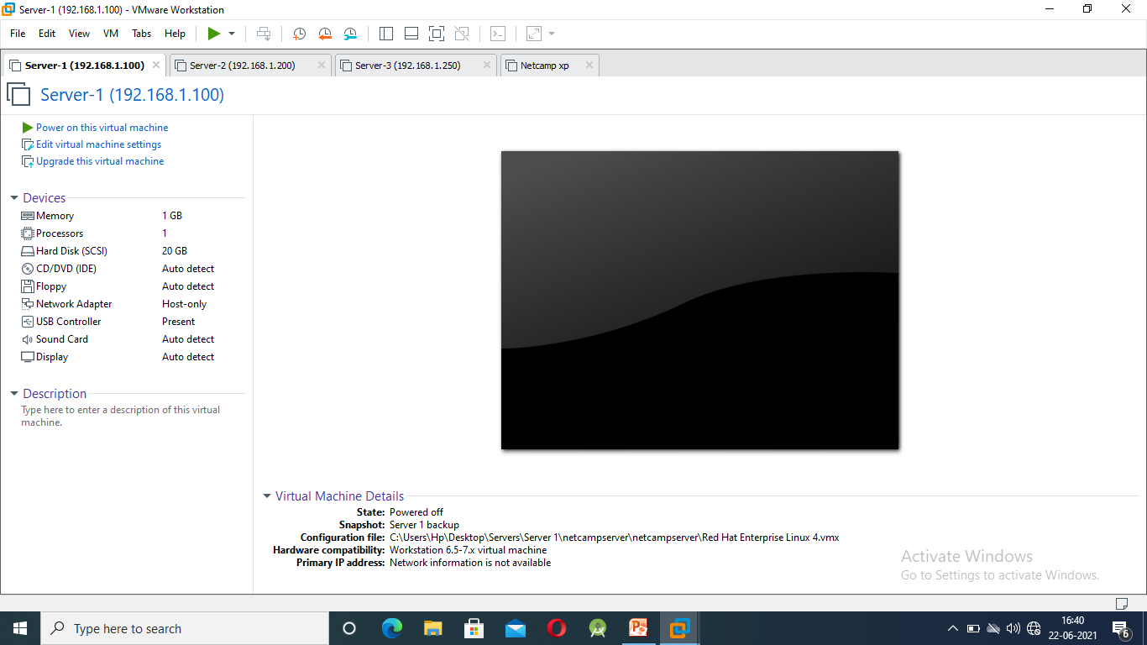
SERVER: Create two servers, give them their IP addresses. IP’s is given to the server with the below given commands in Linux .
netconfig - This command is used to give the IP address to the server.
service network restart – This command is used to restart the network after configuration
Linux is a case sensitive language, so commands should always be written carefully.
The above shown image is a VM Ware image with 2 server having IP 192.168.1.100 and 192.168.1.200 and a virtual Windows to run our code.

Slide 11
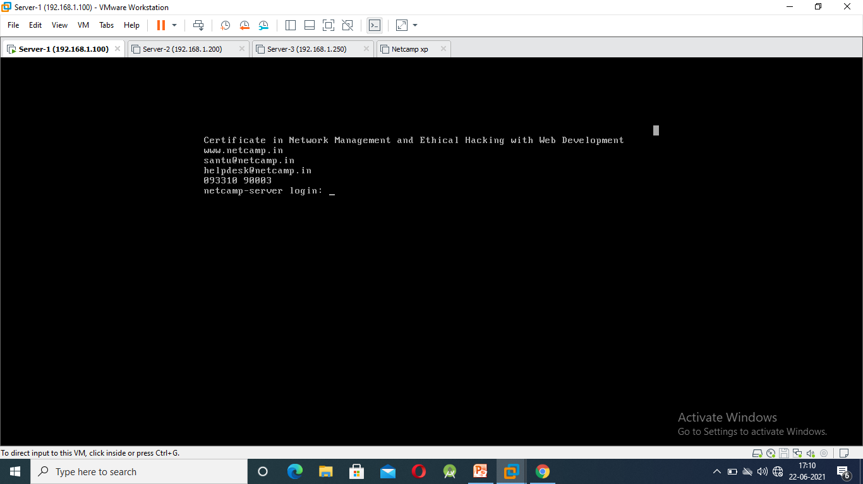
This is the linux server login page or index page. After logging with the correct credentials you are now authorised to make the changes in your sever.
Linux support two types of users 1) Root (Administrative) 2) Normal
Root has access to all the files and folder in the server whereas Normal user can only work according to the permission of the files and folder.
Login Credentials for the linux in this server is:
Username: root
Password: netcamp

Slide 12
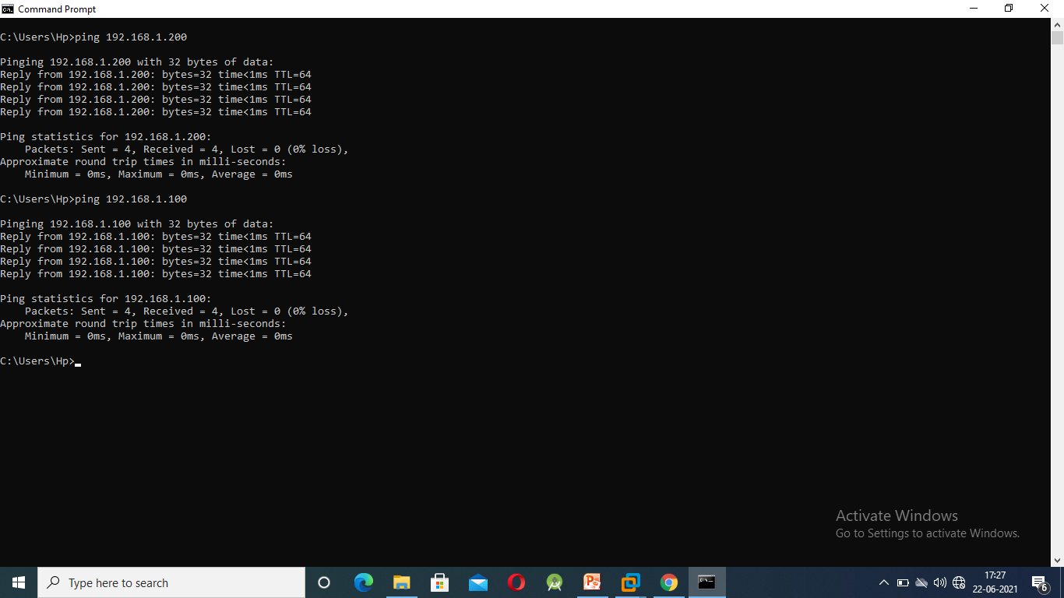
After power on of the VM Ware server, our first priority is to check that the connection is made or not between the VM net card and the server. To check this we open command prompt and write the code.
This code will tell us that the connection is made.
Code for command prompt is “Ping IP address”
In our problem statement our server is having a IP of 100 and 200 respectively.
Ping 192.168.1.100
Ping 192.168.1.200

Slide 13
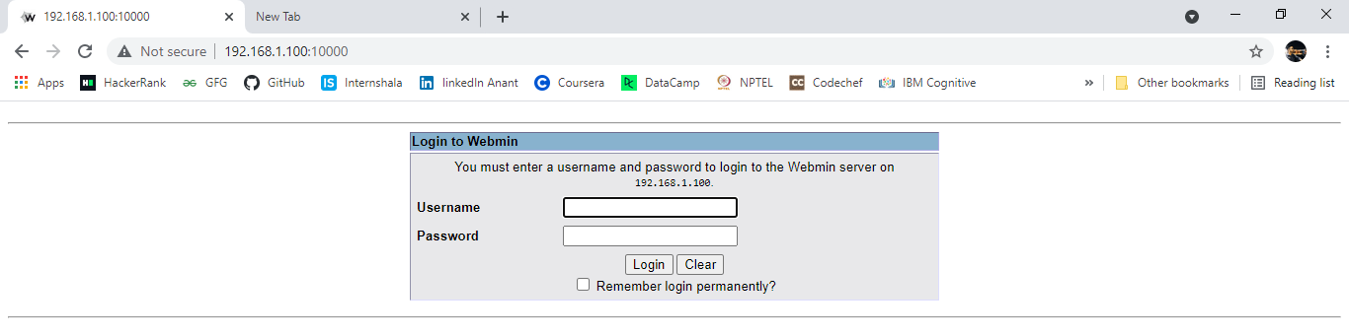
WEBMIN: Login to webmin, as VM Ware has a preinstalled Webmin all we have to do is just login with correct credentials.
Webmin on a browser is open by just writing the IP address along with colon 10000.
In our PS we will login through 192.168.1.100:10000 & 192.168.1.200:10000.
Login Credentials are same as that of linux.
In the username we are allowed to enter “root” user
and the password would be “netcamp”.

Slide 14
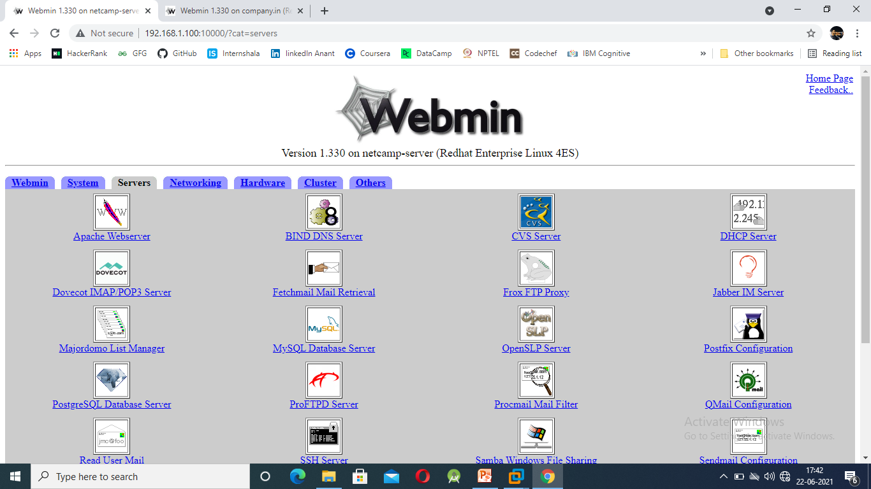
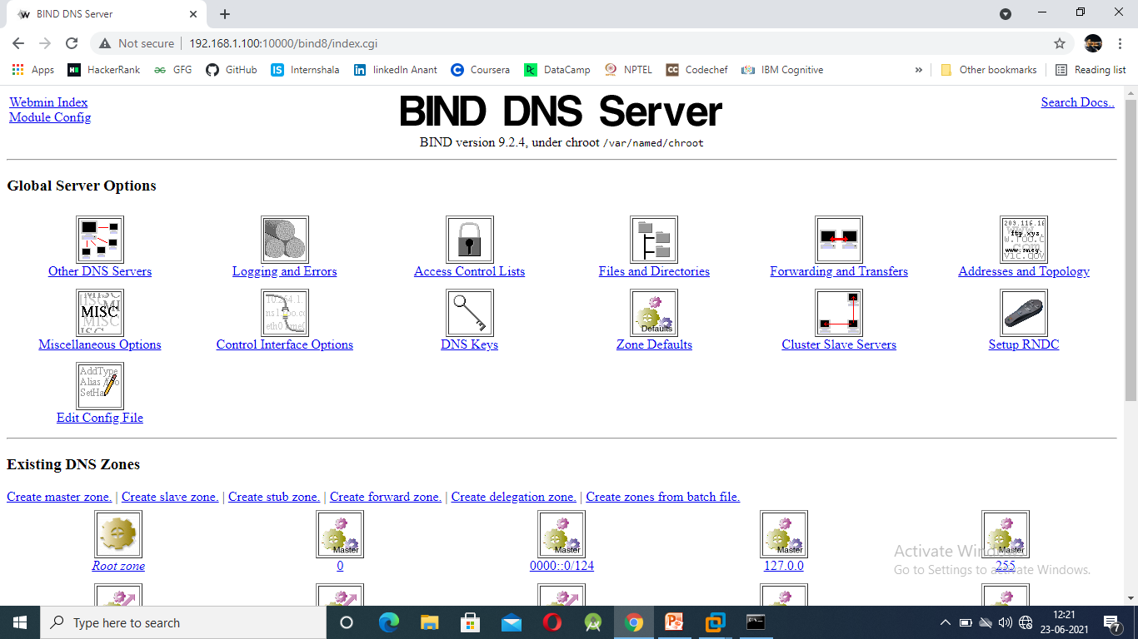
DOMAIN: After opening the webmin Click on the sever, the below displayed page will appear. We have to go to bind DNS server for creating our domain. In our PS we have to create two domains NETCAMP.IN and COMPANY.IN.
Netcamp.in will be given a IP address 192.168.1.100
Company.in will be given a IP address 192.168.1.200
* Click on create master zone will allow you to create domain.

Slide 15
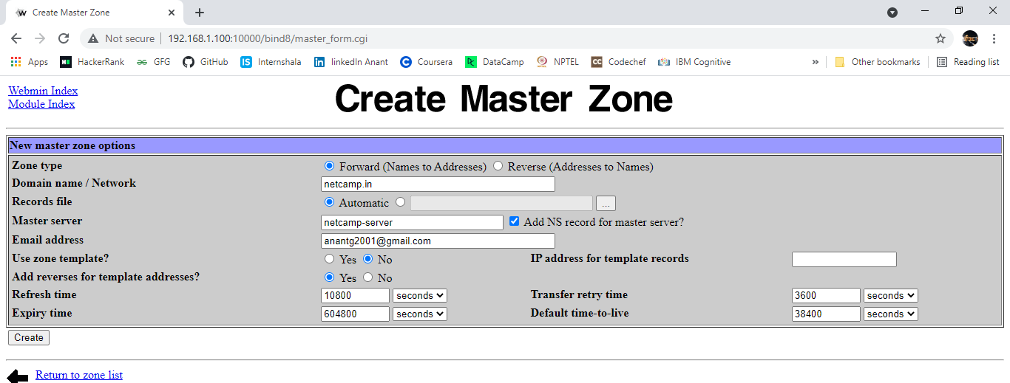
Here we will write the domain name and will also provide the email address.
Email address are provided just because, when we will host our website later in future our domain where we are hosting our website will expire.
So giving email will help you get the warning mails regarding your domain expire.
After filling all the details we are required to click on the create button.
Hence now are site has been created and now we can make our subdomains.

Slide 16
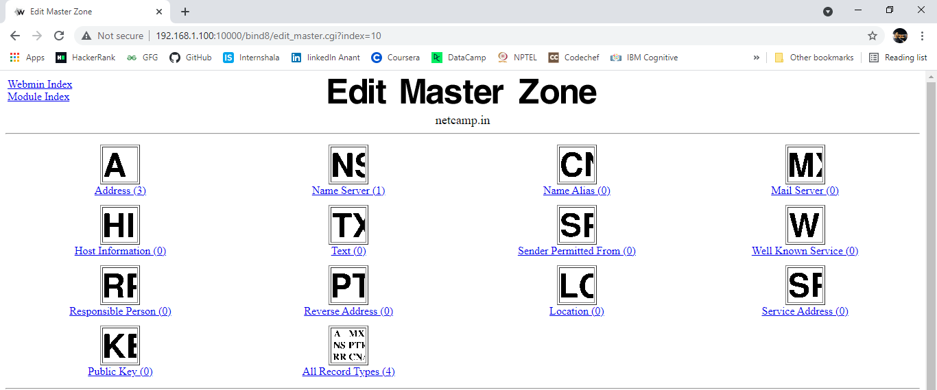
Just after clicking on the create button we are directed to this page i.e. Edit Master Zone
Here at the address we are required to fill the IP address of main domain as well as subdomains. This configuration will be done in both the servers i.e. Netcamp.in and Company.in
Mail server will be created at MX server of 192.168.1.200, as Mail server will be created in this IP
According to the PS (Problem Statement).

Slide 17
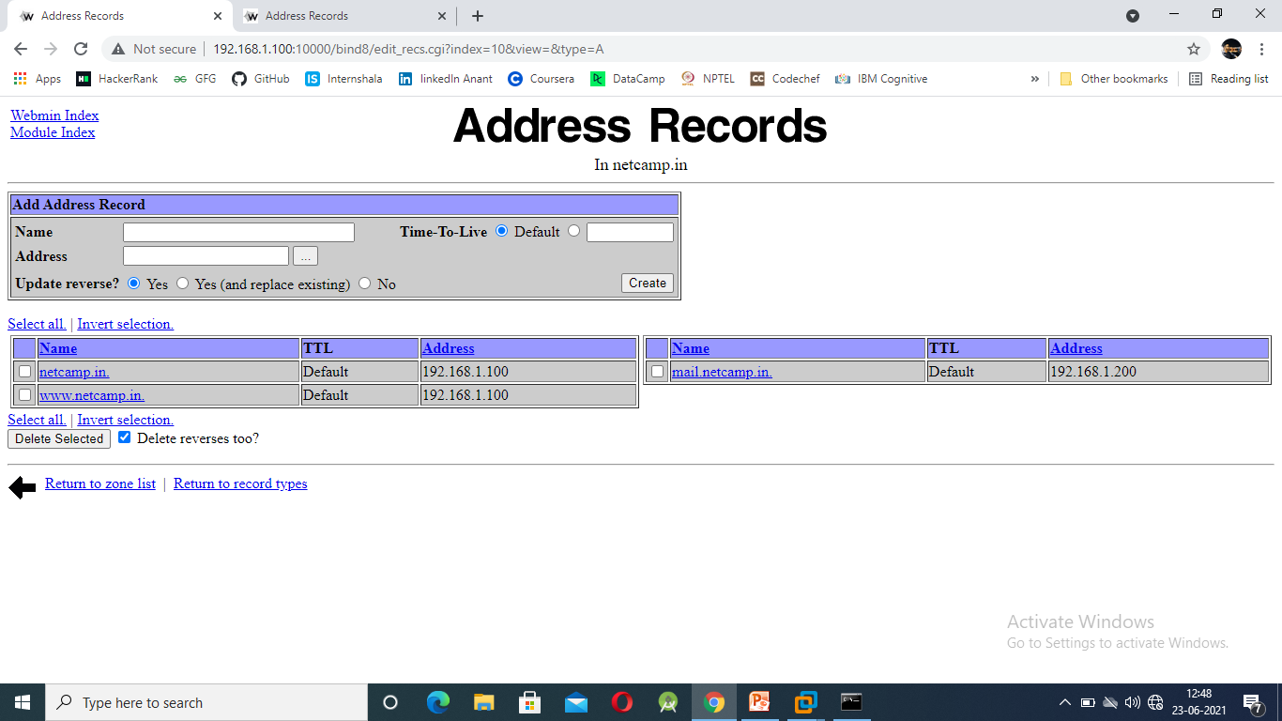
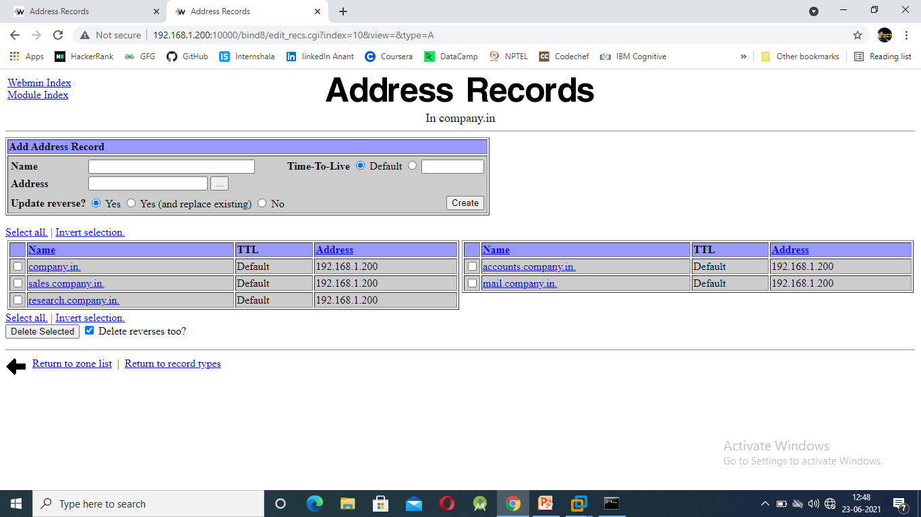
After filing the IP addresses of all the domains and subdomains of different server go to the previous page.

Slide 18
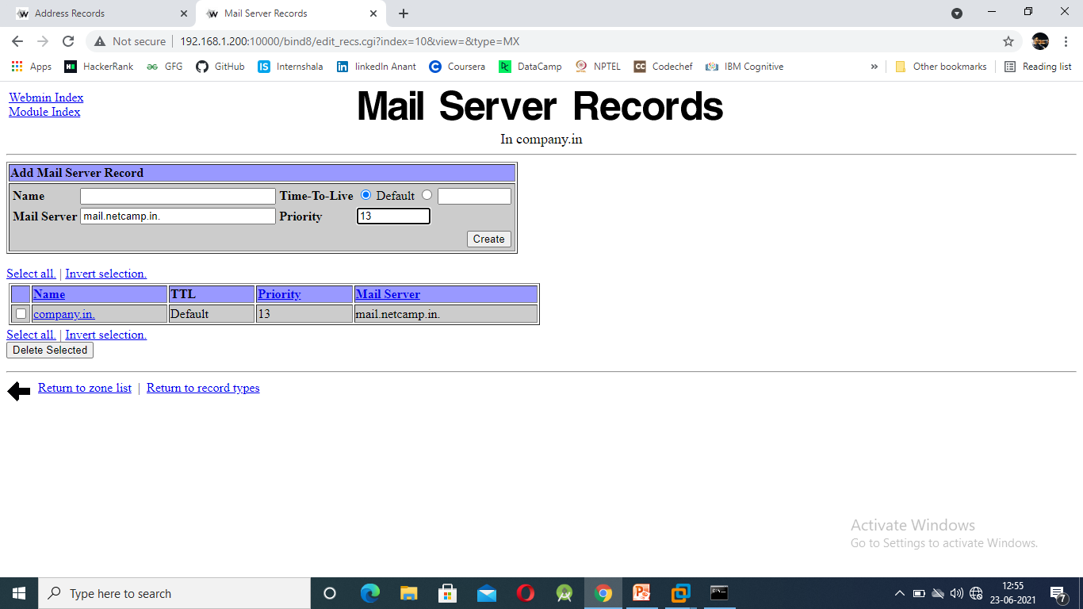
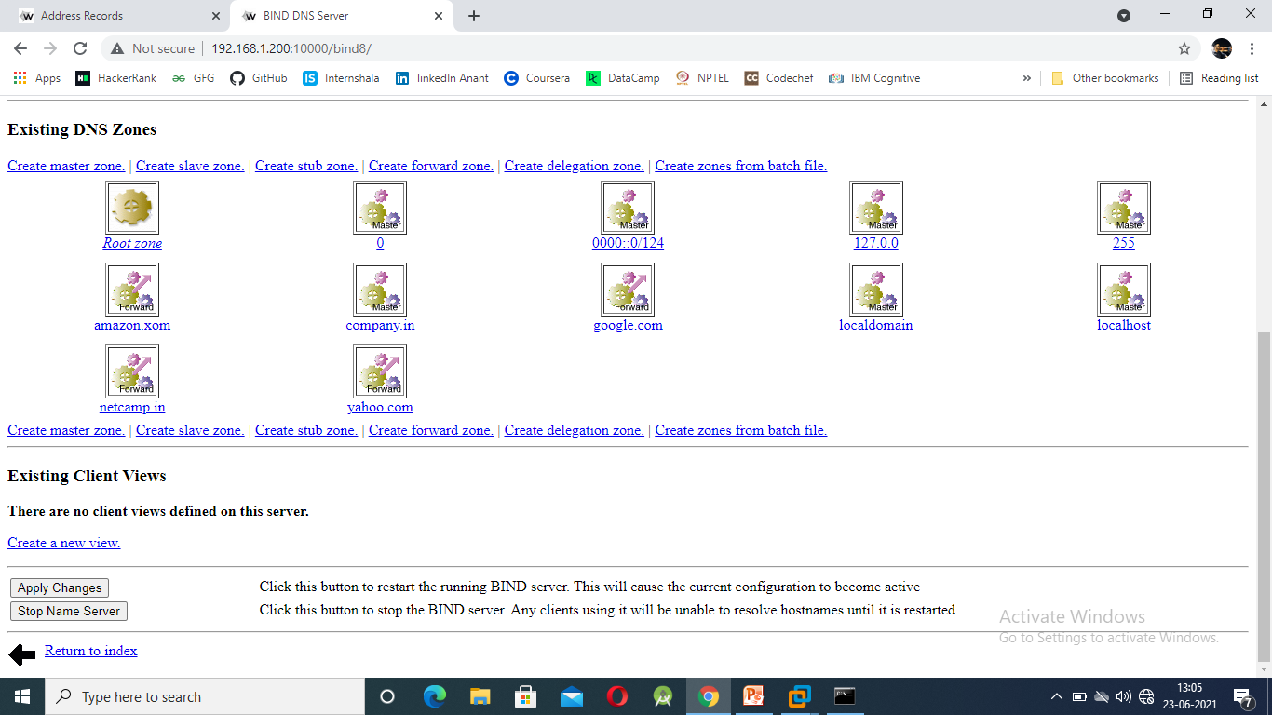
MAIL SERVER: Here we will provide the mail address domains. At this point we are required to put a (.) at the end of the mail server i.e. mail.netcamp.in.
Here we have to set the priority of the mail server as this will decide how important is you webmail at the server.
After configuring all the entries we are now required to move to the Edit master zone again and start the name server. After the name server gets started we are required to click on the apply changes

Slide 19
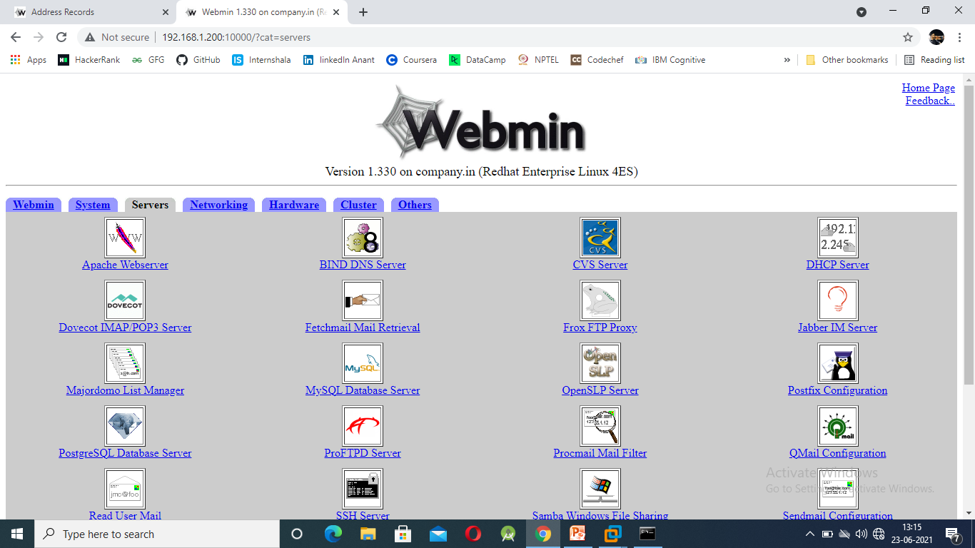
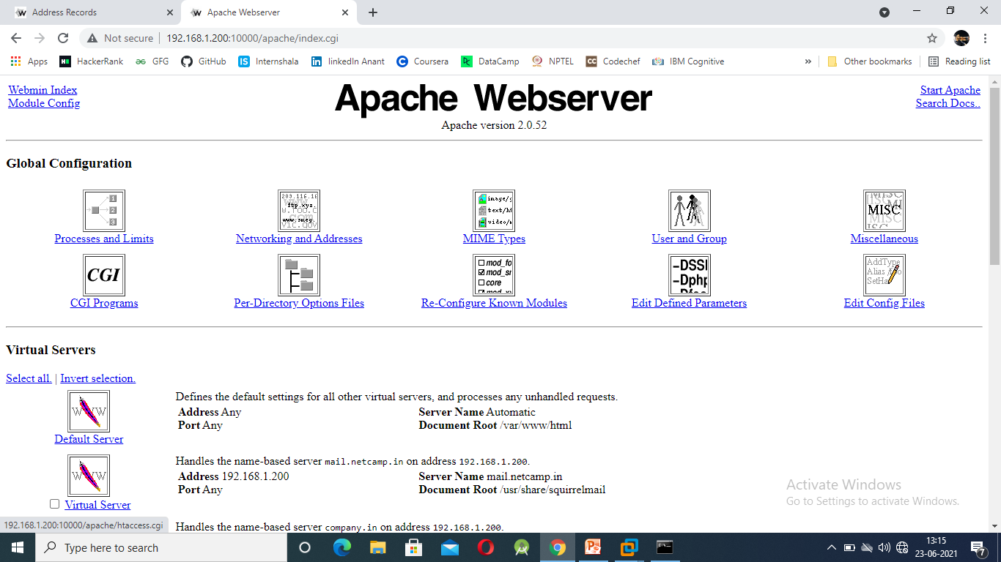
HOSTING: Open apache webserver this is done for hosting your domain.
At the apache webserver fill you entries i.e. the IP address of the domains and subdomains.
The domains name i.e. netcamp.in or mail.netcamp.in.
Hosting will be done in both of the servers. The files that will be selected form the directory will be created first.
This will be done with the help of telnet.

Slide 20
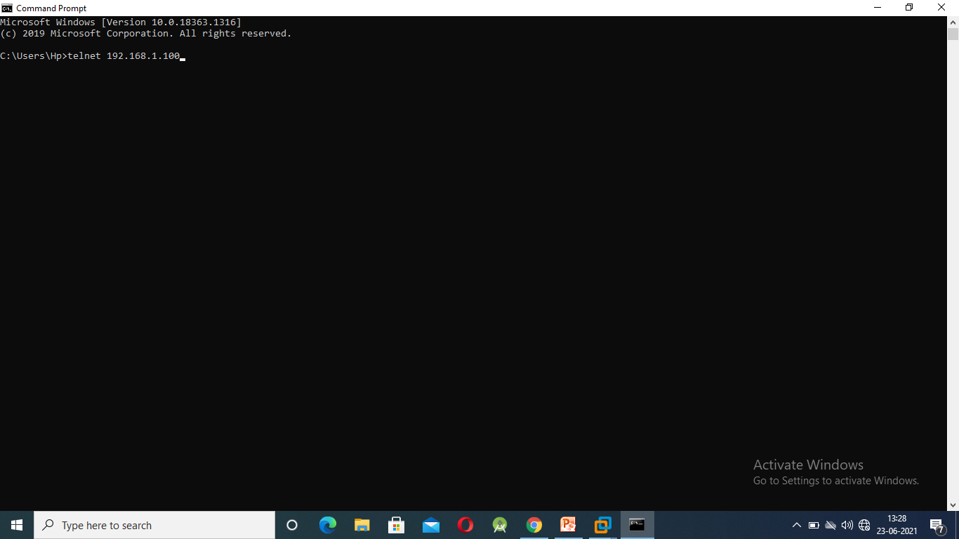
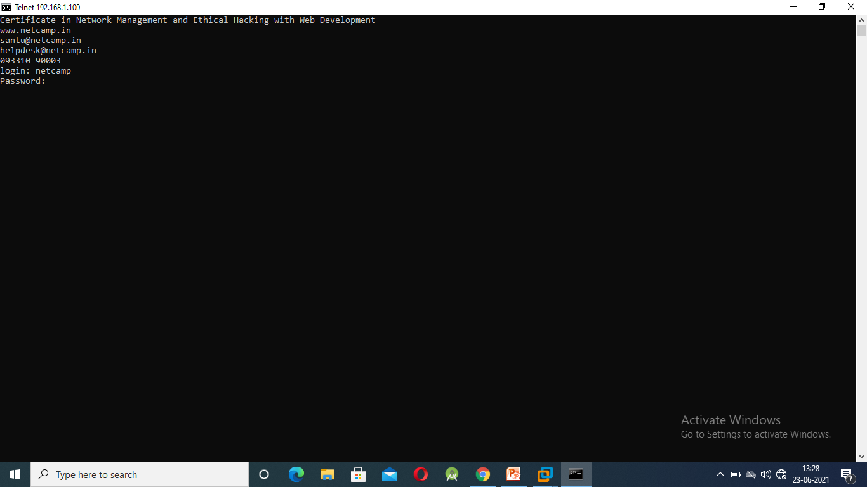
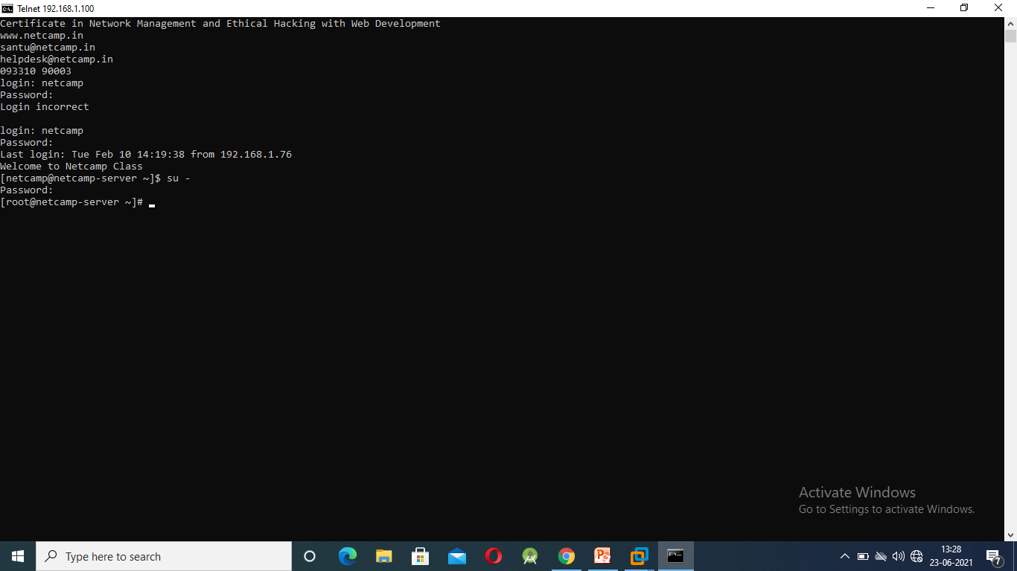
TELNET: This is the port no 23 and is used to login to the server with the help of command prompt. To open server just write telnet 192.168.1.100 & telnet 192.168.1.200 in two tabs.
After the server gets connected to the cmd pmt you are required to login with the normal user i.e netcamp and password used will also be netcamp i.e. same of linux server.
Since normal user are not allowed to do the changes, so we are required to login with the root user. To convert the normal user to root user we use the command su - . This command will make the user the root user and now we are allowed to make the changes.
Now we will create a folder by any name which will be displayed on the index page of the domain and subdomain.
Folder will be created in the / directory i.e. /webnet
In webnet a file will be created index.html as this file will only show the content entered in it.
We will perform this process to create the folders according to our PS.

Slide 21
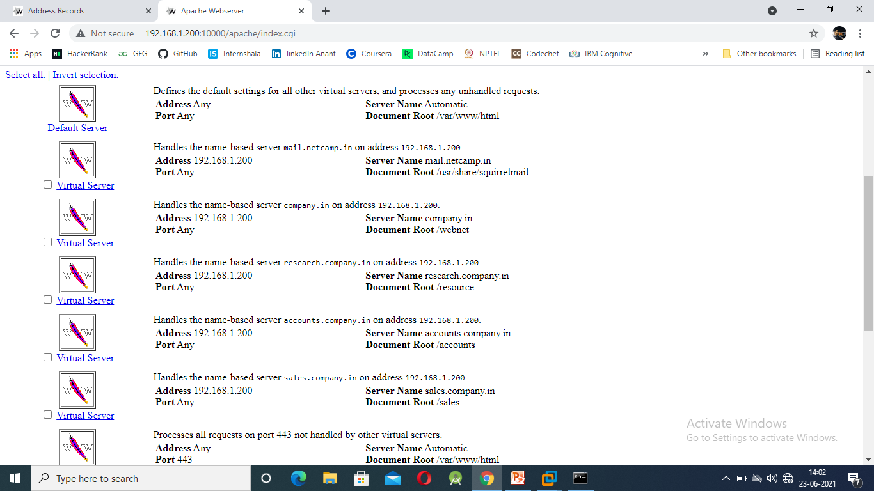
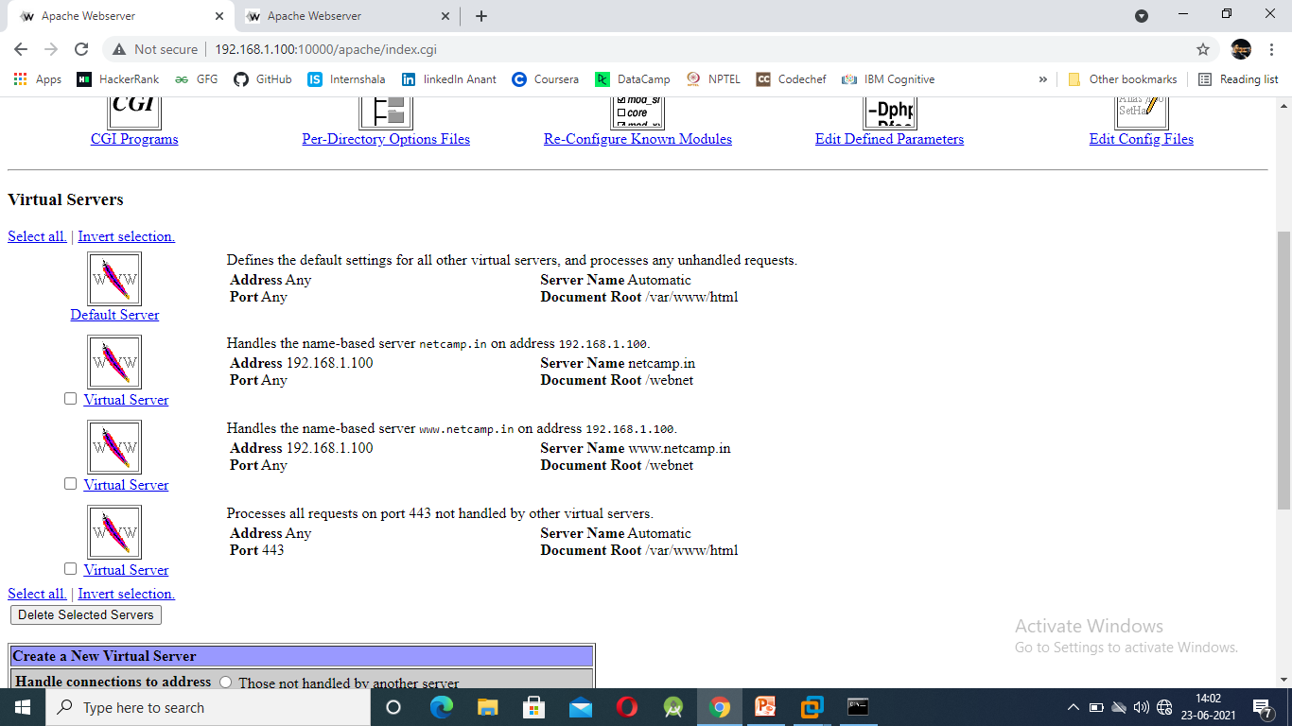

Slide 22
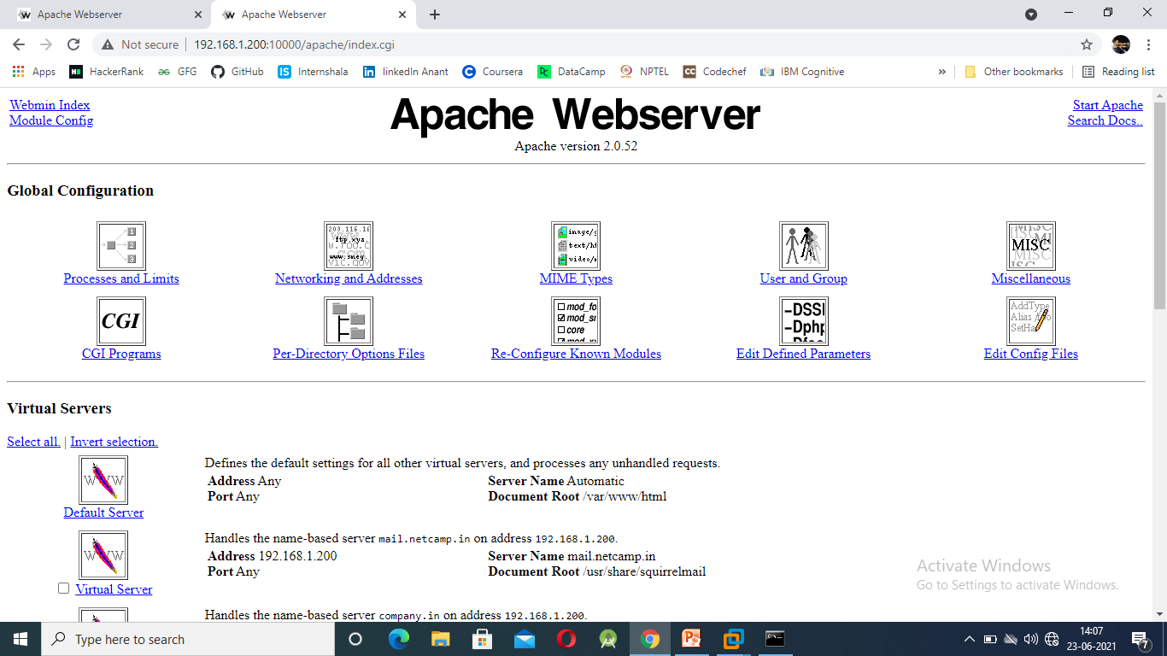
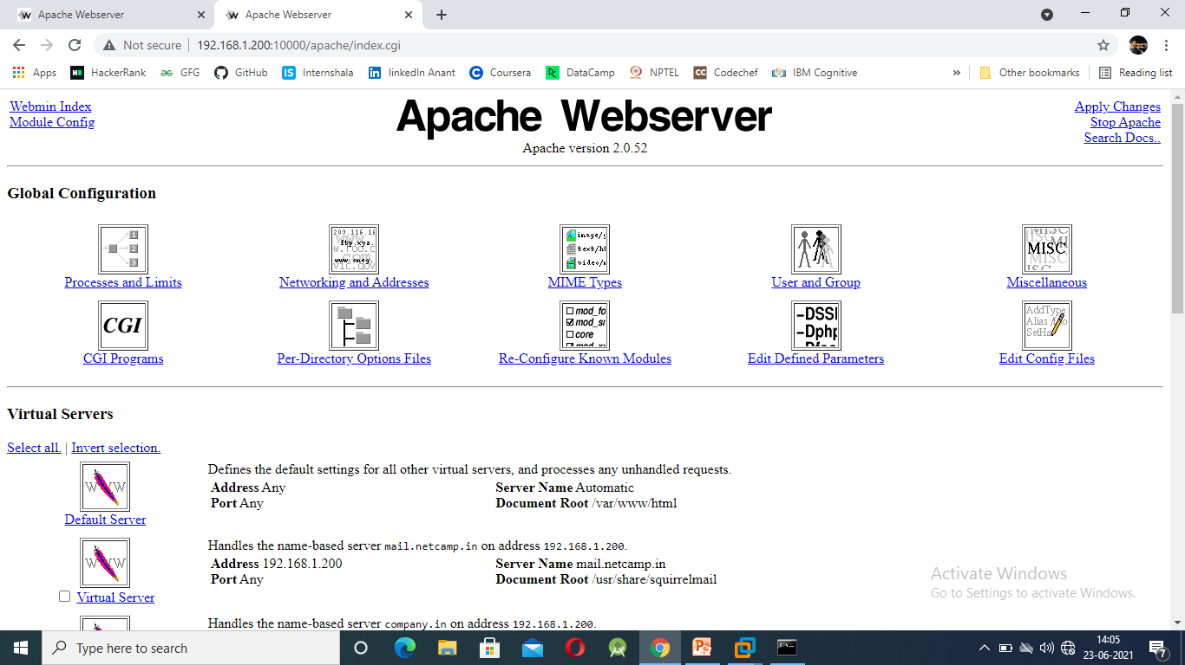
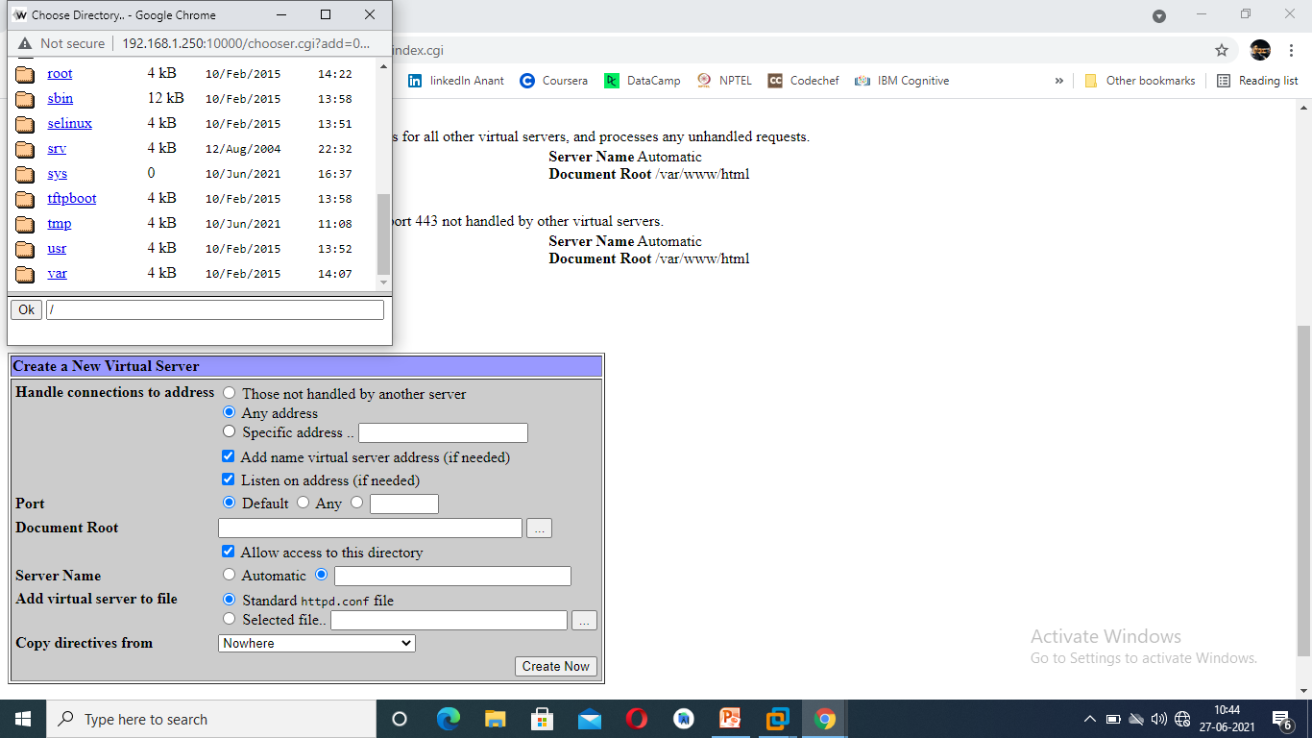
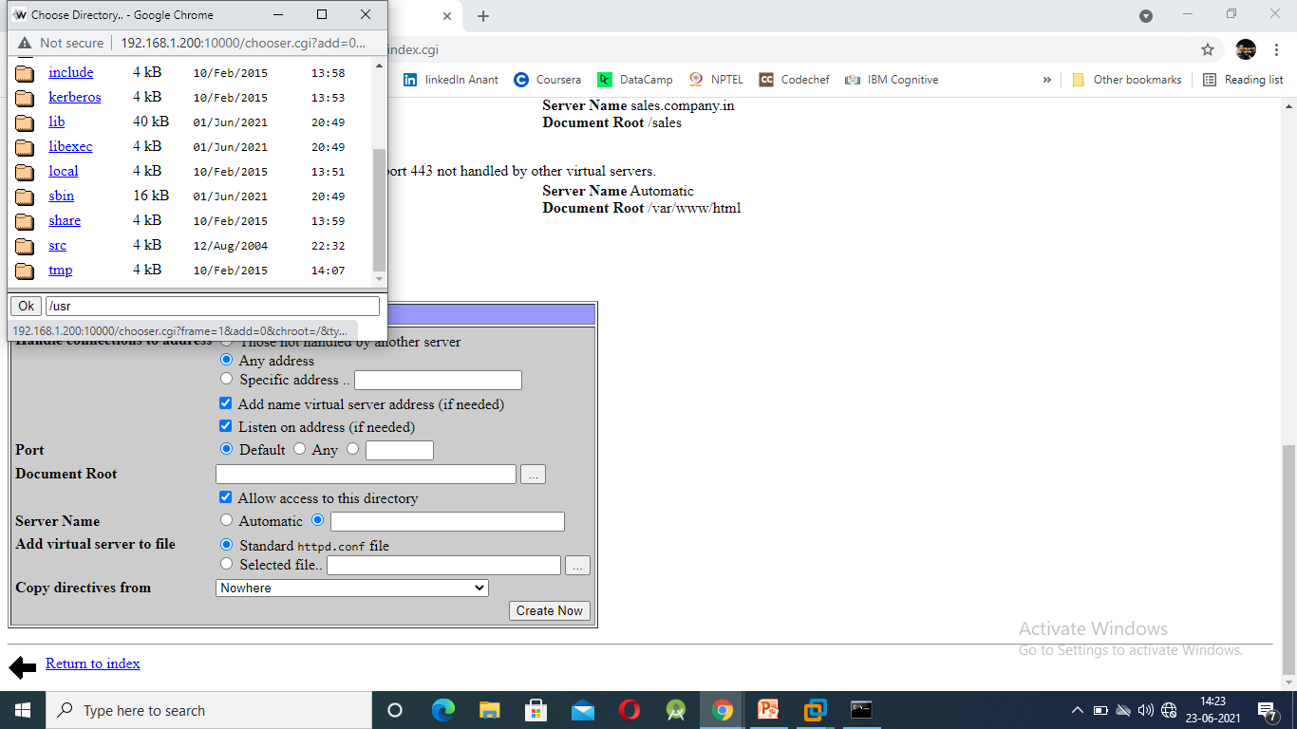
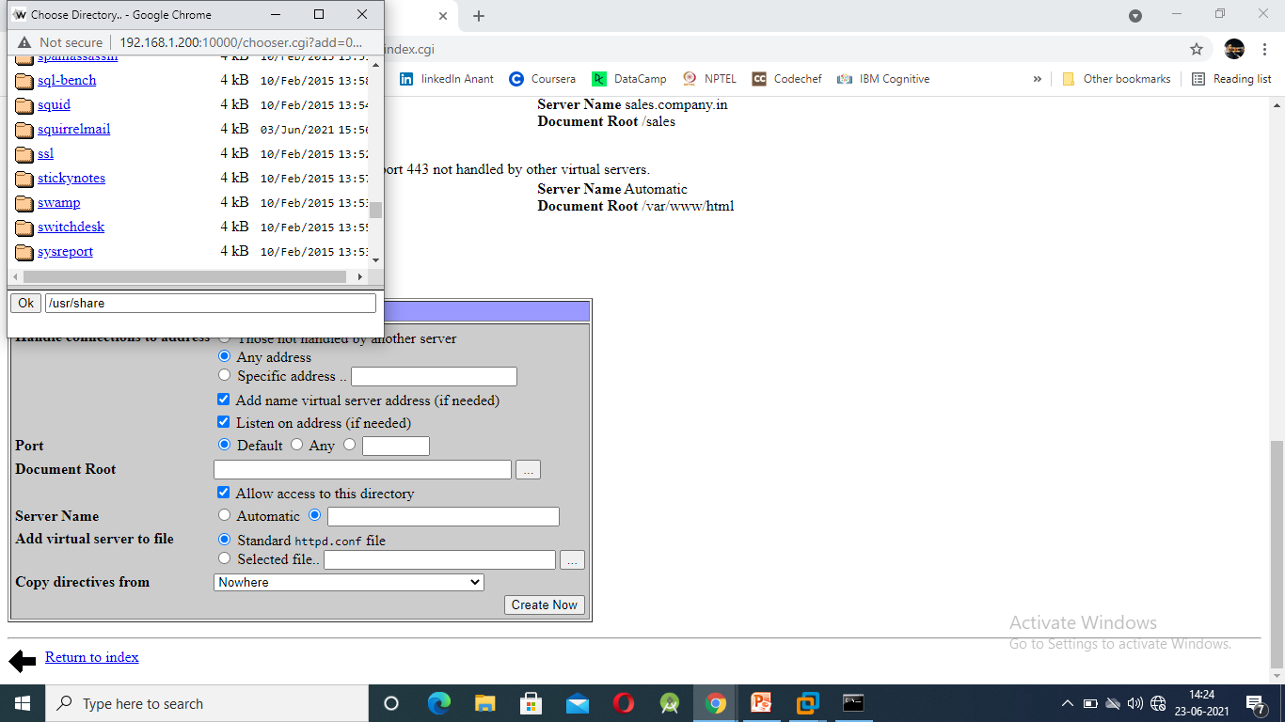
After we are done with our configuration i.e. setting the directory of each domains and subdomains in the apache web server our job is to first start the apache server.
After starting the apache server you are required to apply changes.
IMPORTANT NOTE: When you are selecting the directory for the subdomain mail.netcamp.in(192.168.1.200) you have to select the directory /usr/share/squirrelmail
As this is the file which will enable mail service to your domain.

Slide 23

DHCP CONFIGURATION: This is done to connect multiple pc’s to a single server at a single shot. This saves the manual time for connecting the each pc’s to the sever.
While giving IP at the DHCP server we should keep in mind that we don’t provide the Network Address(NA), Broadcast Address(BA), Router/Gateway Address, DHCP own address.
The only thing that DHCP server will have is IP address (POOL), DNS server, Subnet mask, Gateway IP.
Using DHCP we can block the entire network as just by changing it’s current network to different network.

Slide 24
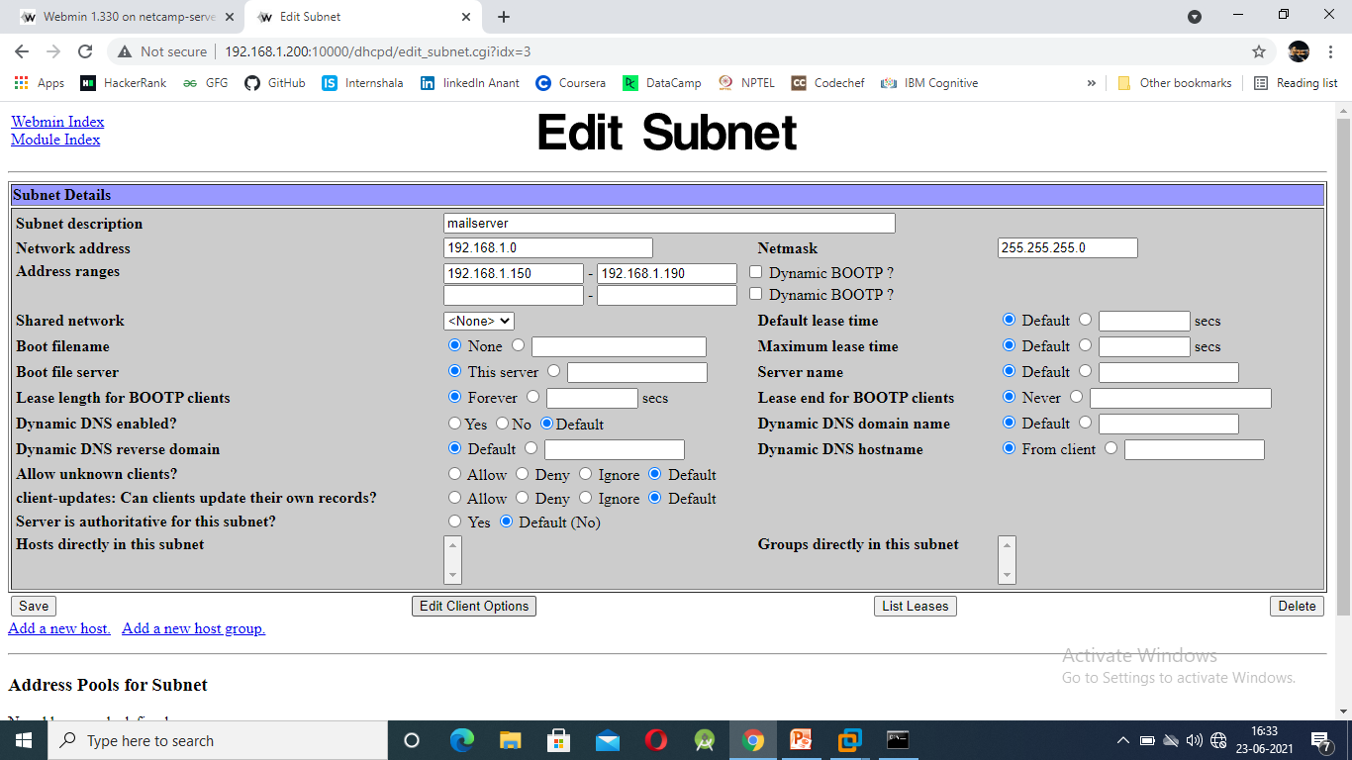
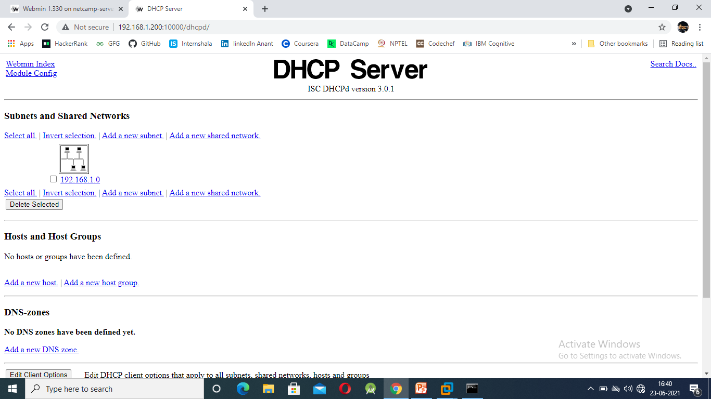
Your entry should be in the ranges, as DHCP works only in the ranges. Here in our PS we have our range from 192.168.1.150 to 192.168.1.190.
In this DHCP server we have our gateway address as 192.168.1.0 and a netmask as 255.255.255.0
After configuring the entries we have to save the data . The data after entry looks like this:

Slide 25
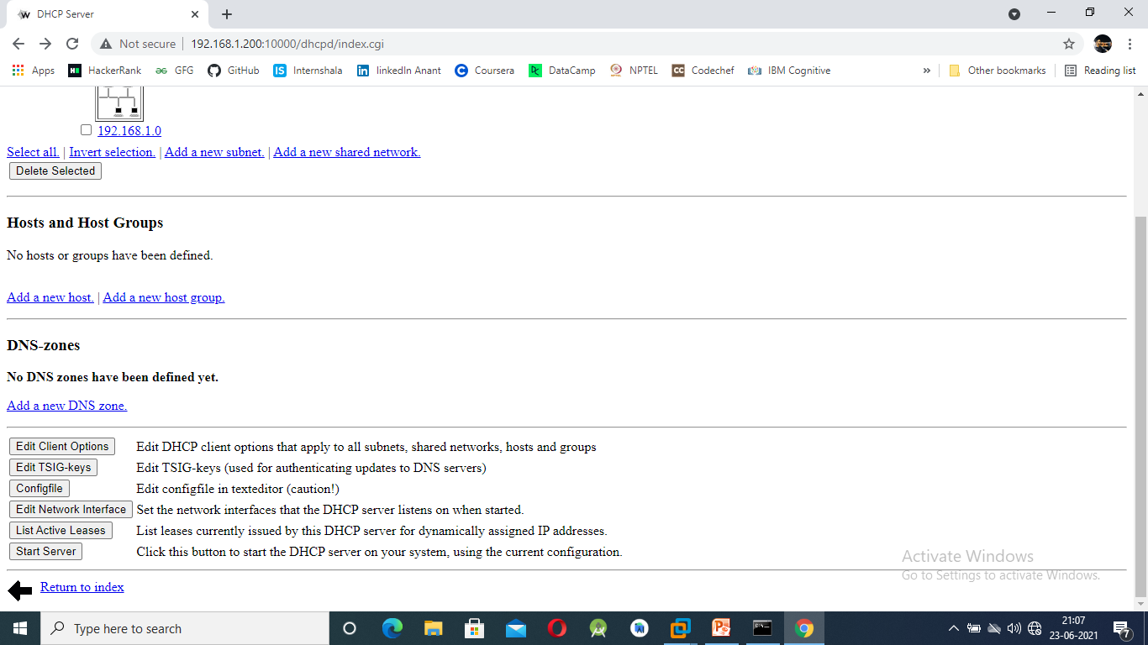
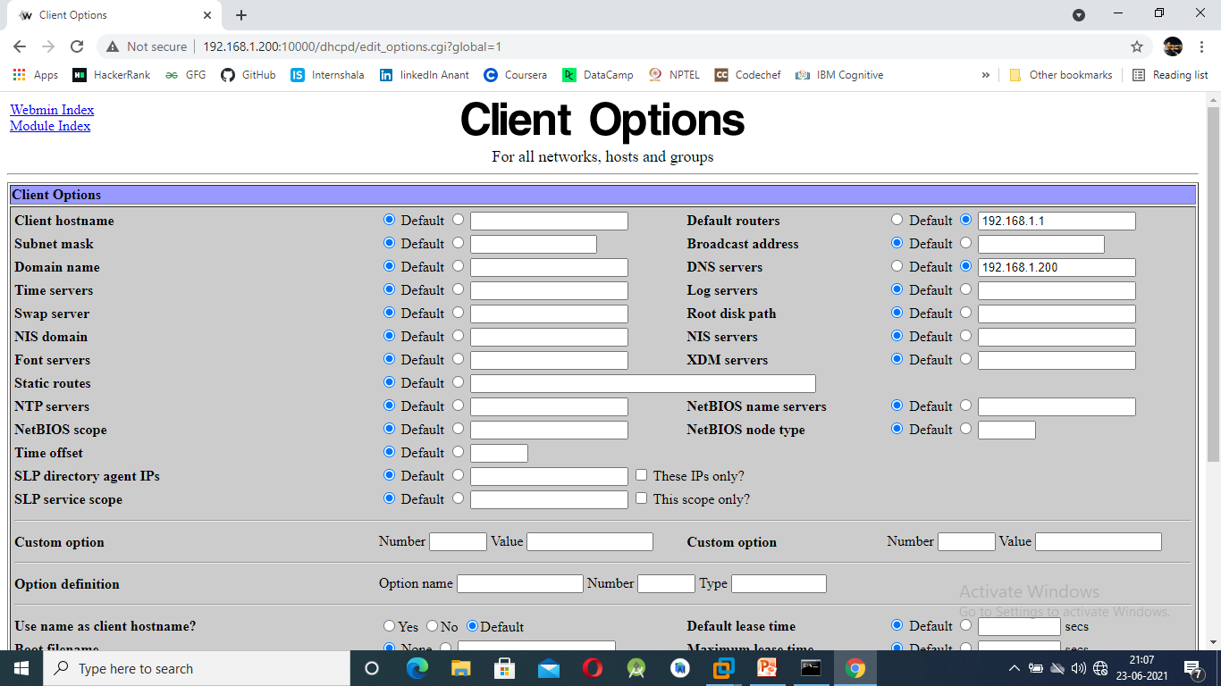
After saving the DHCP server configuration we now have to edit client options.
Click on Edit Client Options
This page will open. Now we have to fill the entries at Routers and Servers by changing the permission to manual
Router address and server address are given in the above picture.

Slide 26
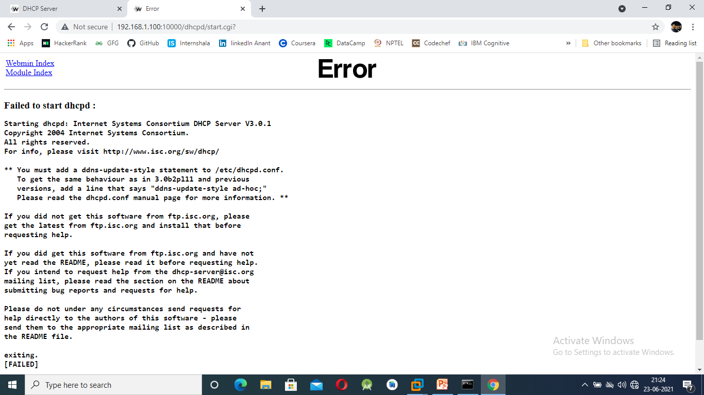
Now after configuring all the entries, click on the ‘Start Server’
When you will click on the start server you’ll get a error message displayed on the screen, which says that you should add this line(“ddns-update-style ad-hoc;”) in your dhcpd.conf file.

Slide 27
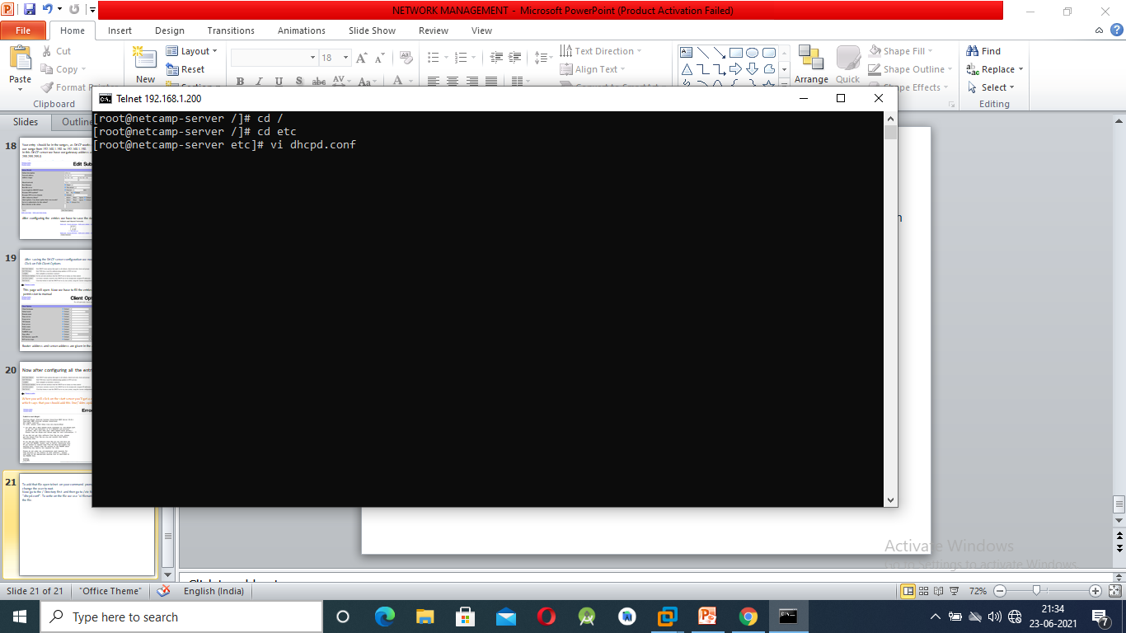

To add that file open telnet on your command prompt and login to 192.168.1.200 and change the user to root.
Now go to the / Directory first and then go to /etc folder and then write on the file “dhcpd.conf”. To write on the file we use ‘vi filename’ command and then press ‘i’ to write in the file.
Insert your file here

Slide 28
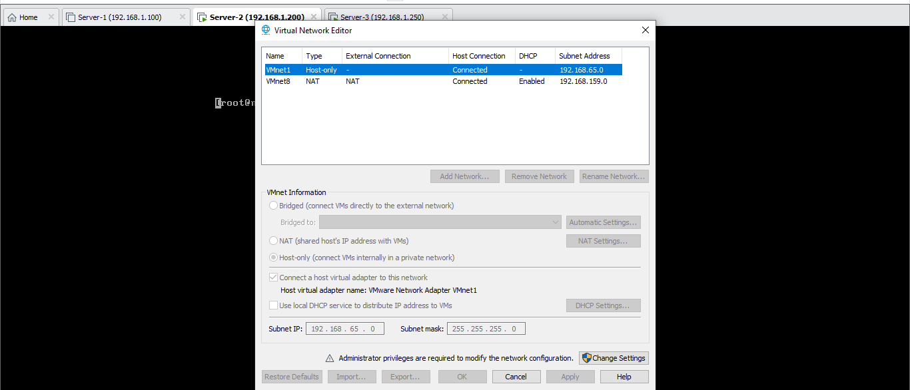
Now open your server, go to edit option then click on virtual.
This dialog box will appear. Here we have to uncheck the local dhcp server, this is done because there are two dhcp server, the one which we have edited and the one is already present in the VM Ware software.
Now your DHCP configuration has been done.

Slide 29
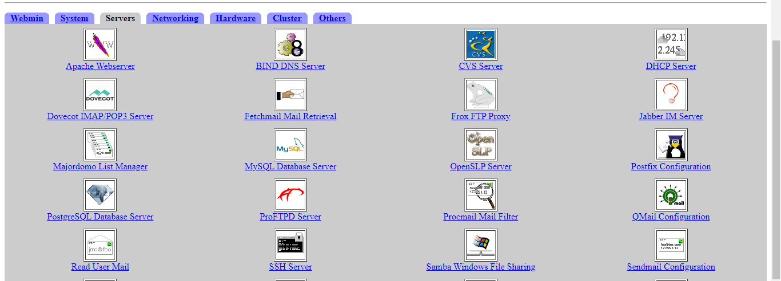
SEND MAIL CONFIGURATION:
Send mail configuration is used to start the mail server. This server allows us to send mail to different person in same domain as well as in other domains.
Send mail also allows us to define the priority of our message that we are sending i.e. it decides that which mail should go first.
After starting the send mail server we are now allowed to send/receive mails.

Slide 30
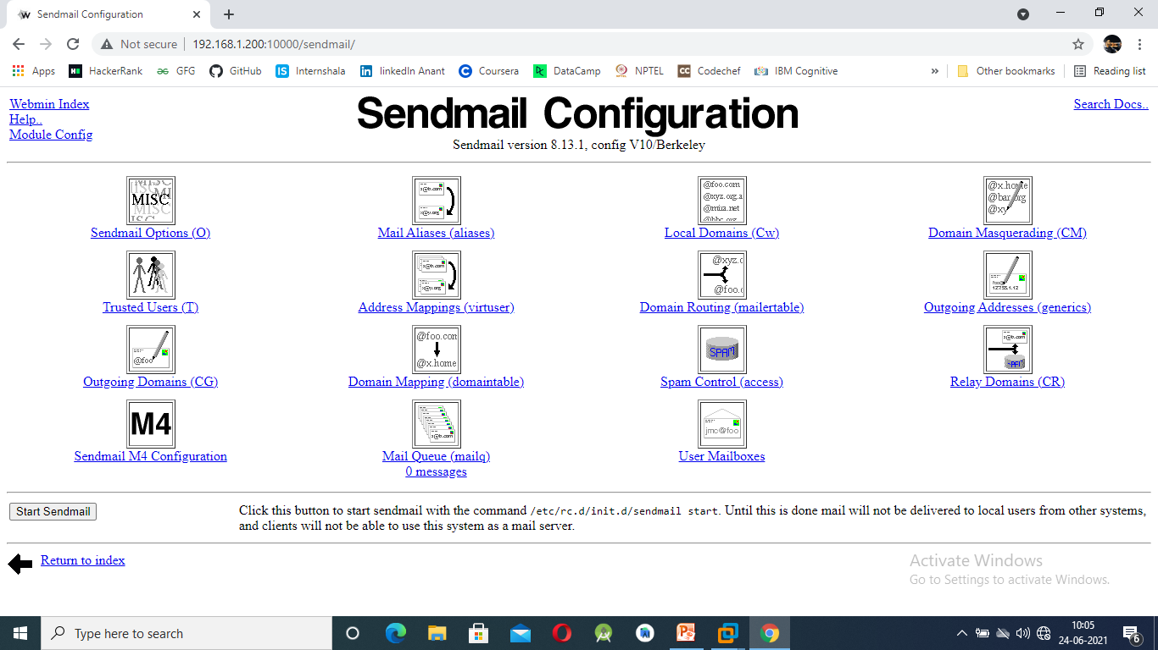
After you click on send mail configuration, the below page is opened.
Now we have to configure send mail options, Local domains and relay domains.

Slide 31
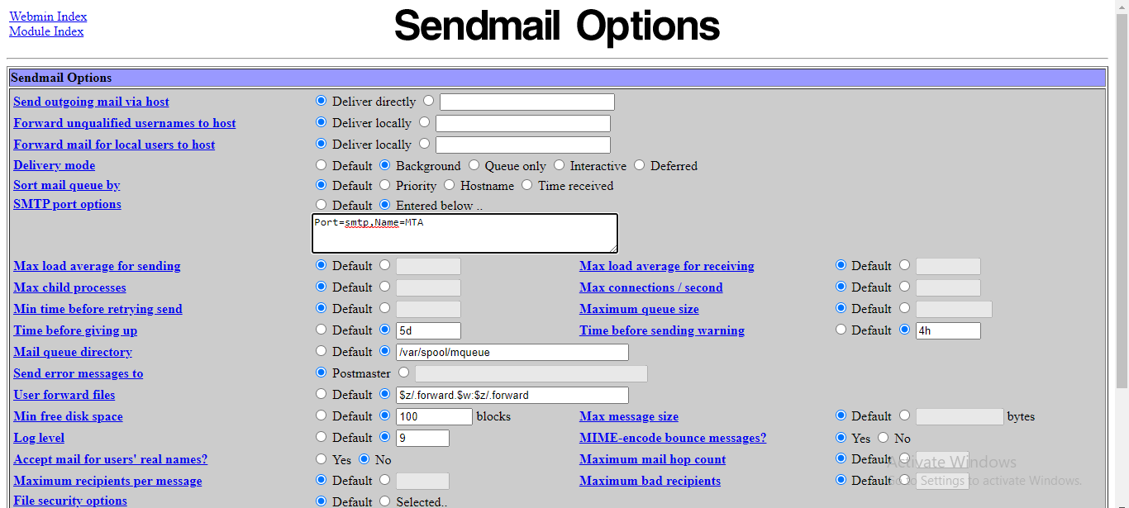
At the smtp port delete the address written over there i.e. ‘addr=277.0.0.0’
Then click on the save button.

Slide 32
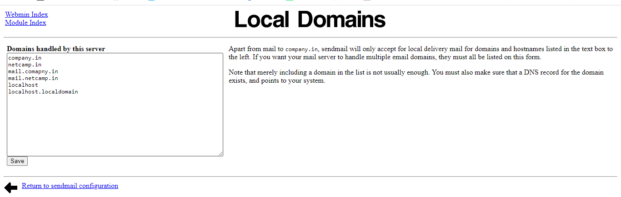
Here you will give the domain’s name where you will send the mails.
It includes the mail server domains and the main domain of the dns server. Then click on save button.

Slide 33
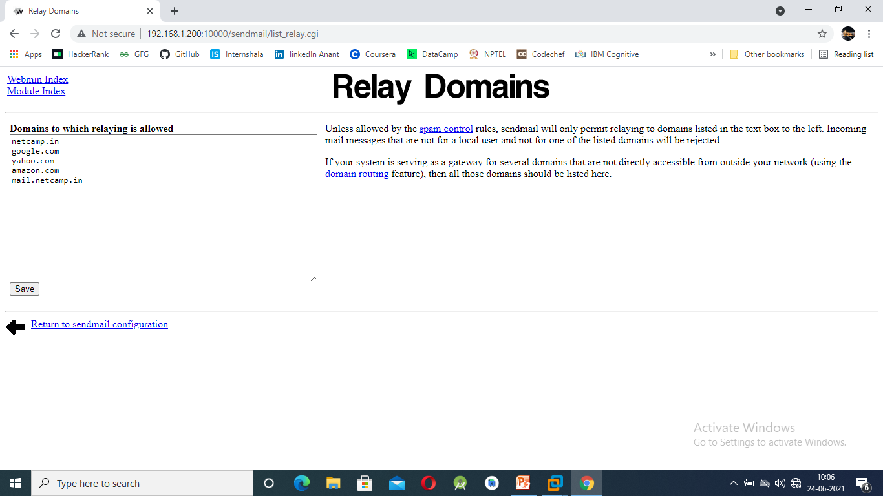
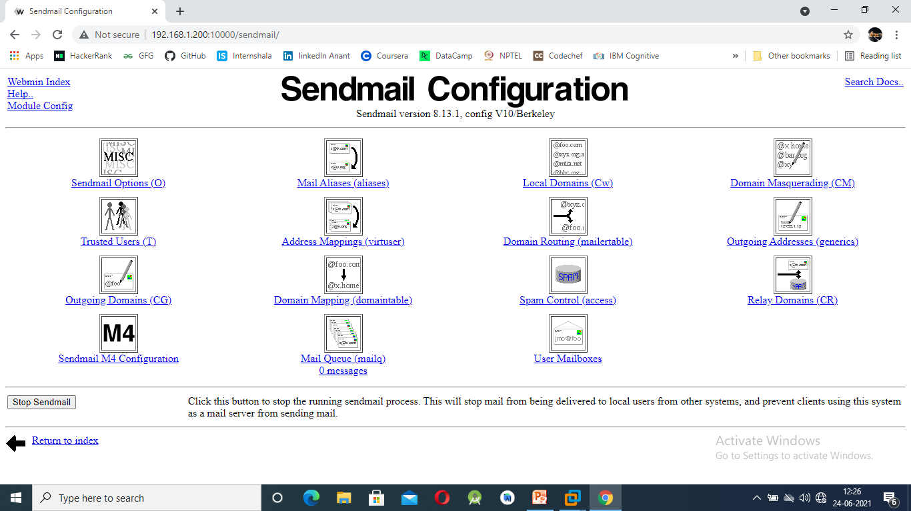
Here we will entry the domains were we want to send our mail
Entries are made here only for the receiver domains.
Here all the forward zone domains are entered mainly.
Now you will start your mail server.
Your mail server has now been started.

Slide 34
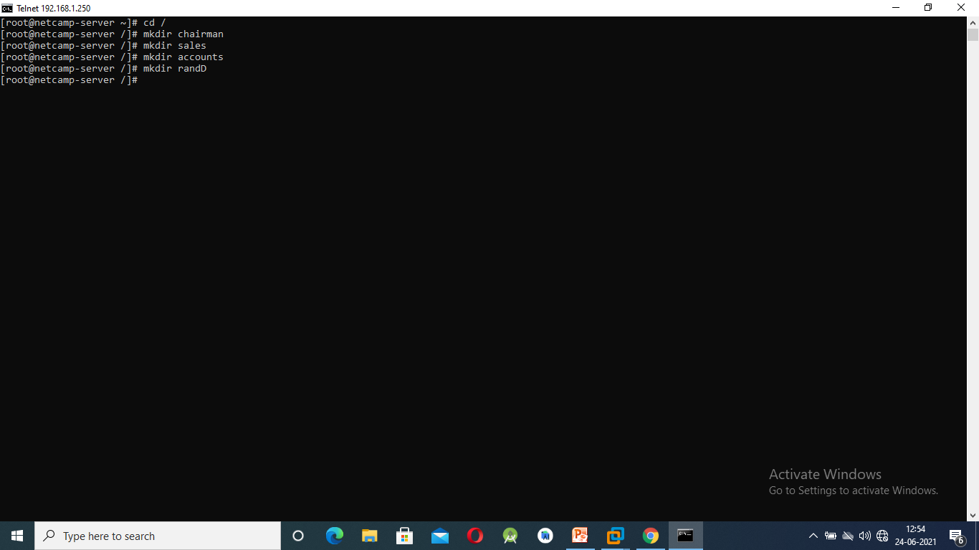
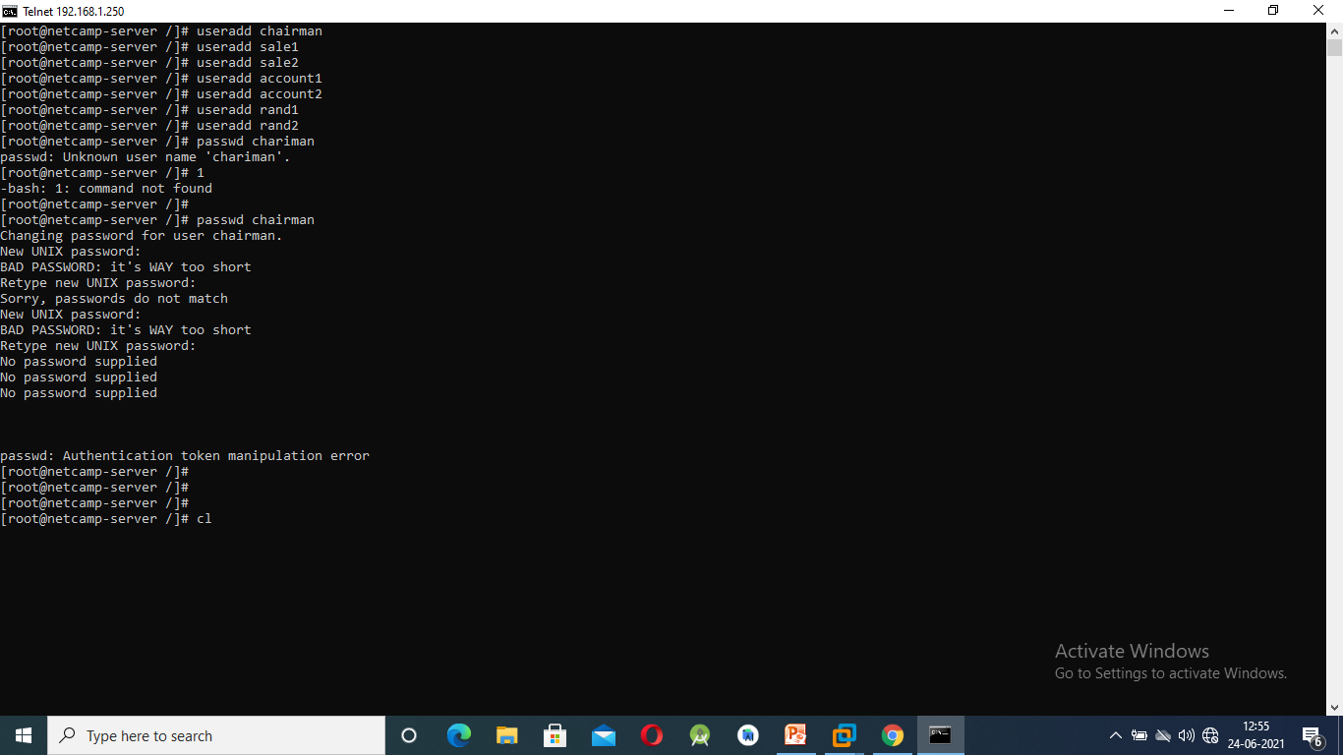
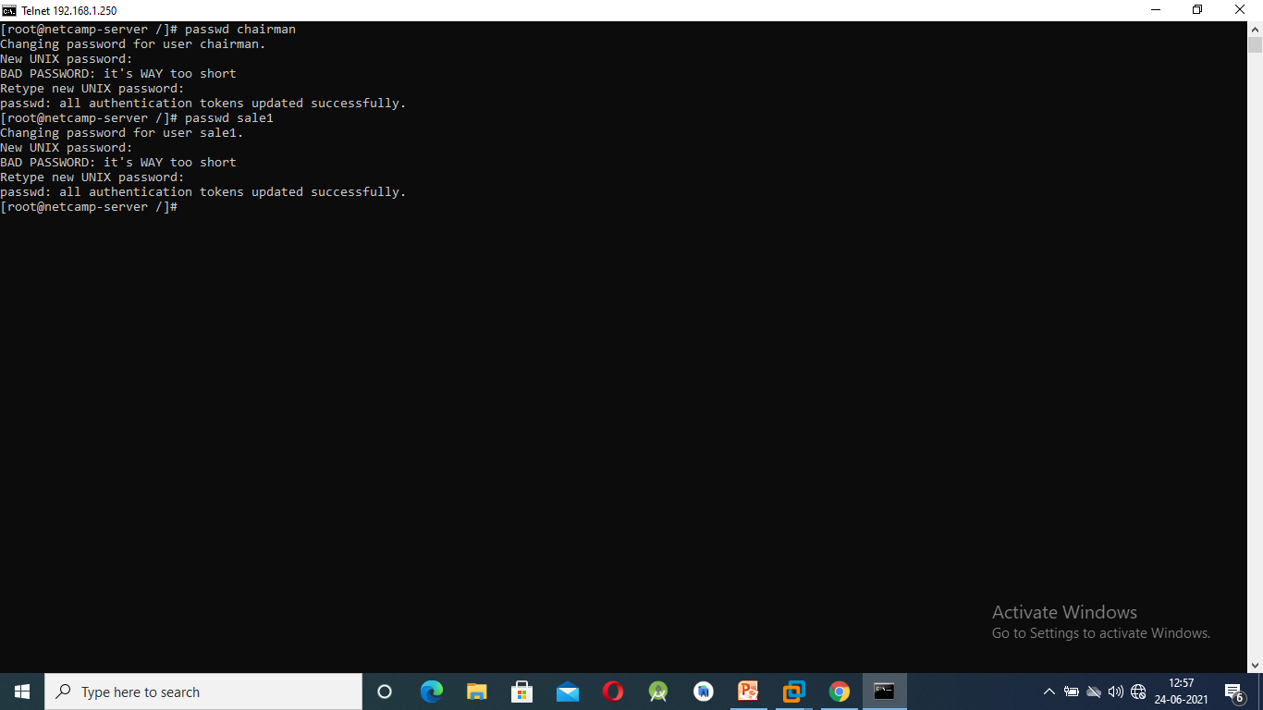
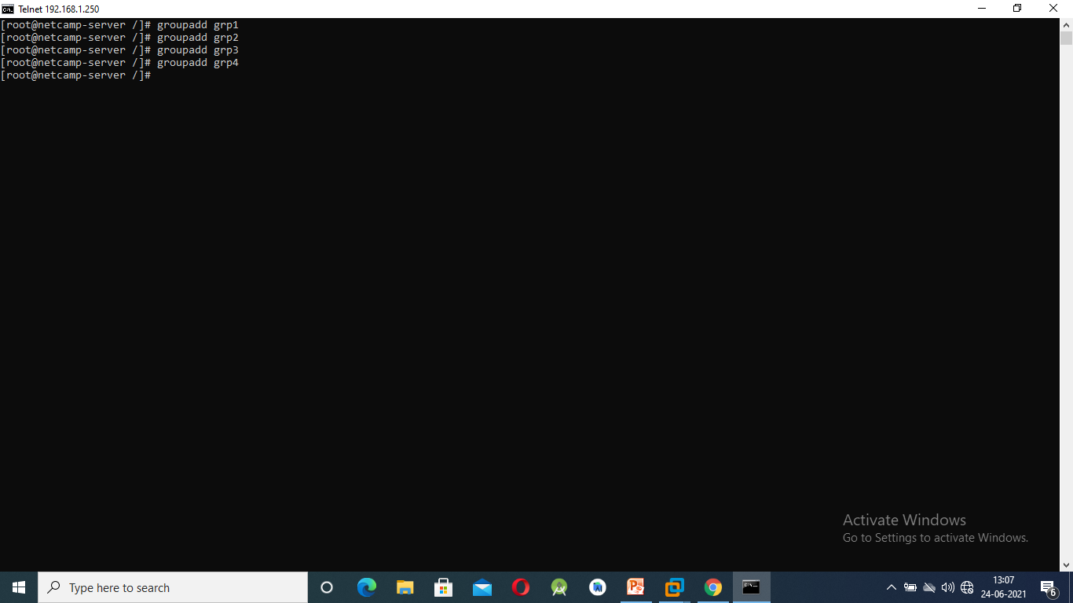
CREATING USER, FILES AND FOLDER
Creating folder according to PS
Creating users.
Giving password to the user
Create a groups grp1,grp2,grp3,grp4

Slide 35
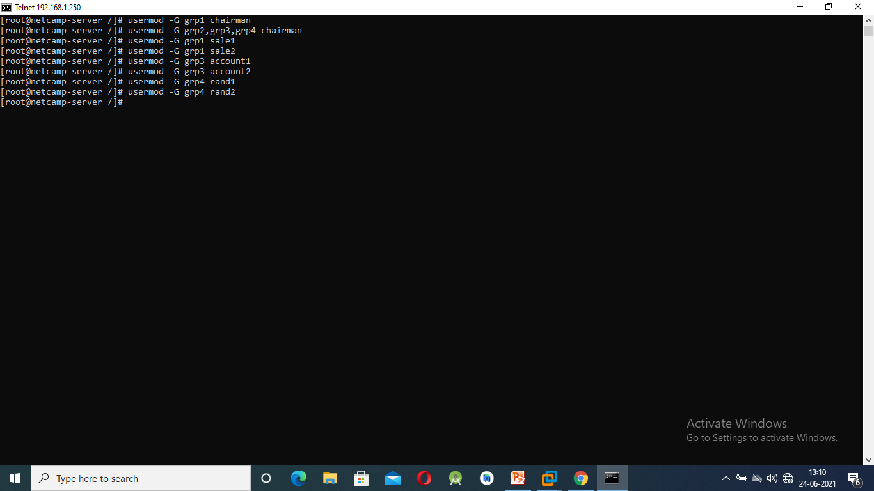


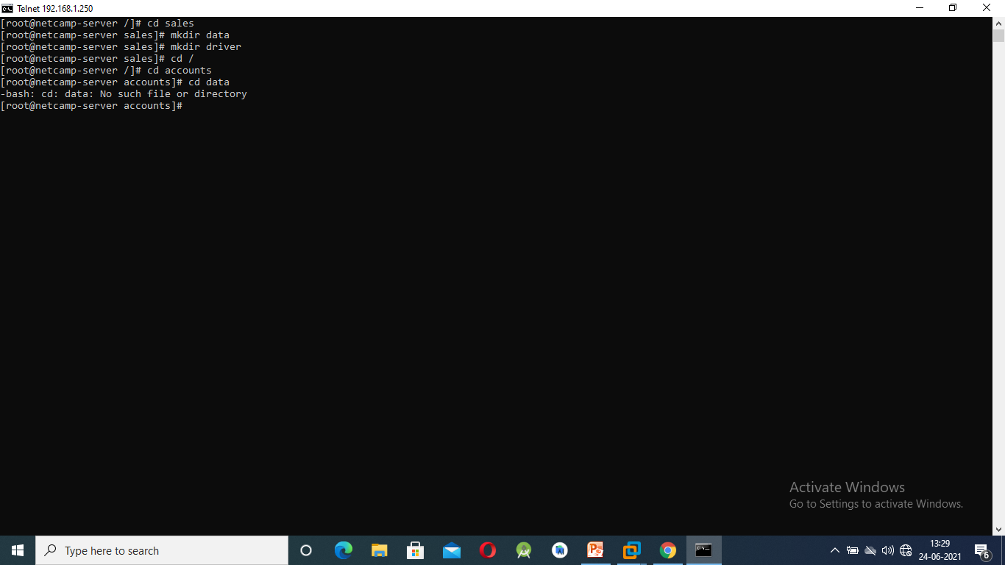

Add user to particular group for permission on given folder.
Change group of chairman, sales, accounts, randD
Change the permission of the all the folder of owner and group.
Create data and driver folder inside each and every main directory according to PS.
Change the permission of data and driver. Change the group of data and driver folder and also add chaiman in all the four group of grp1, grp2, grp3 , grp4.

Slide 36
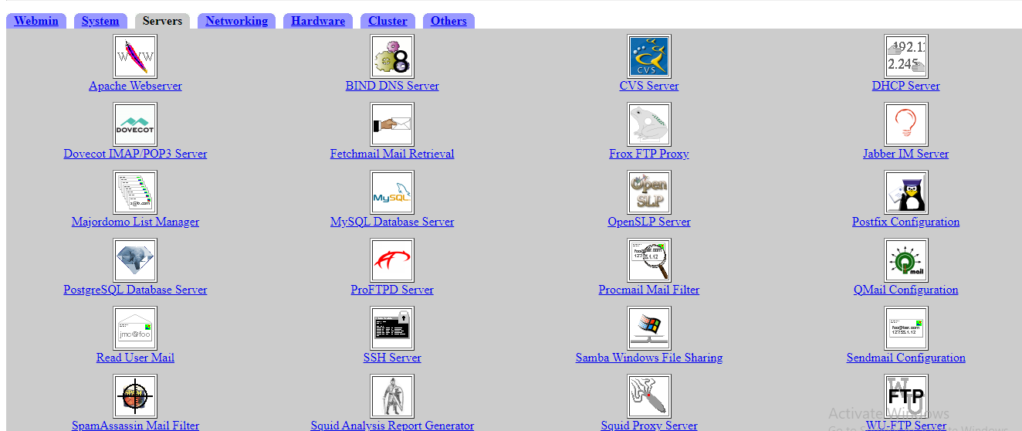
SAMBA SHARE: This share is used for the purpose that it allows your linux files and folders to view on windows. User are just required to login with their server in windows and will be able to make changes in their server while working in windows.
To create samba share we have to click on the samba windows file sharing.

Slide 37
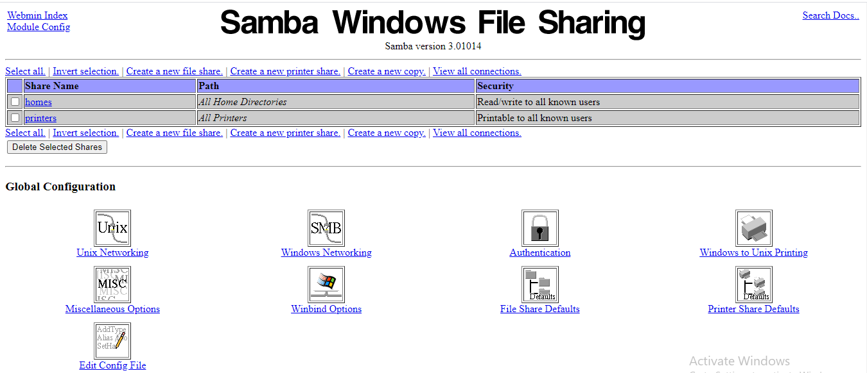
At this page we have to first create a new file share that we want in our windows from the linux server.
Click on the create new file share.

Slide 38
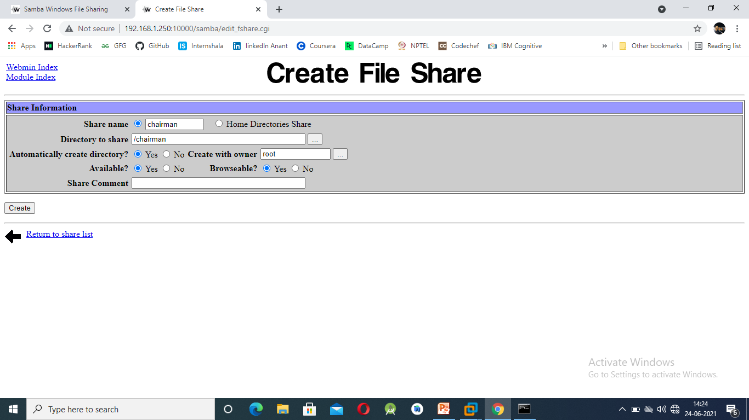
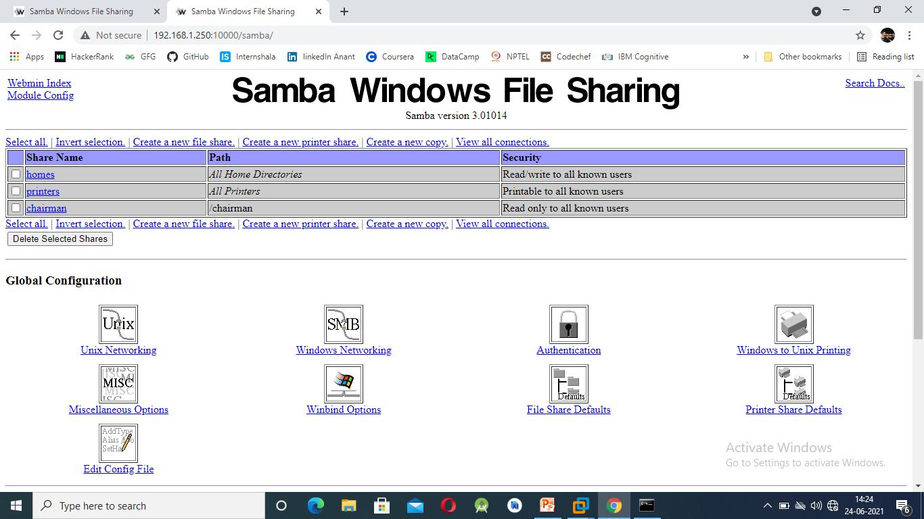
Here we will give the file name that will be displayed on the windows screen.
Directory of the file will be decided by us that which file or folder we are willing to share.
After filling all the entries simply click on create button.
Here I have created a folder share named as chairman and have choose the chairman directory.
After the folder has been created it is now showing in the below screen.
Similarly we are going to add accounts, sales, randD and squirrelmail folder in samba share.

Slide 39
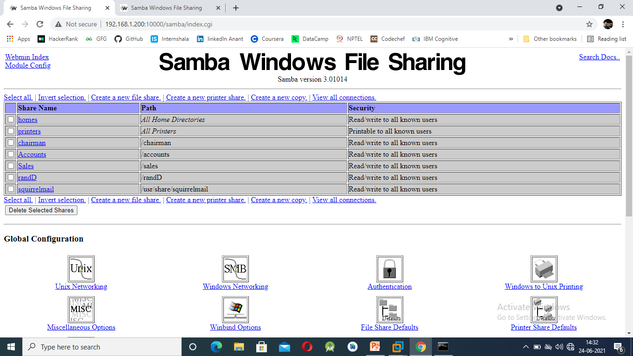
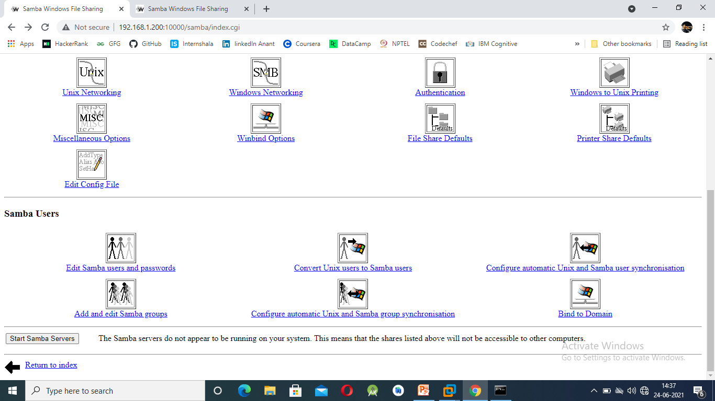
All the department folders are now been selected and are shared through samba.
Now we have to convert the linux user to samba user.
Click on the samba user.

Slide 40
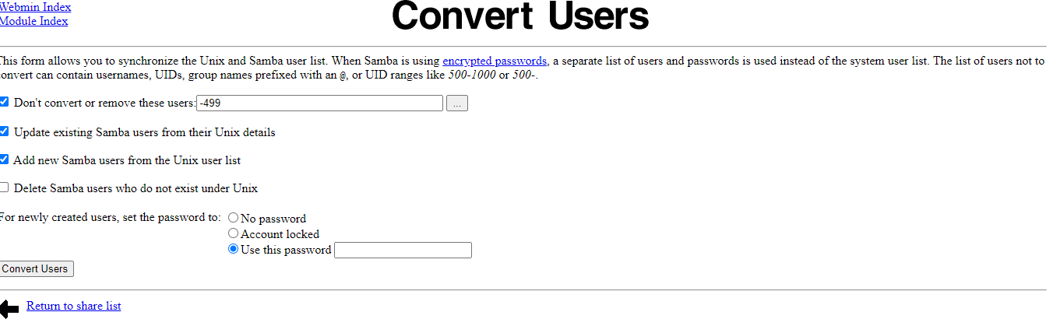
Here we have to entered the password. You can enter any password because it will only create a samba user and will not affect during login.
After typing the password just click on the convert user.

Slide 41


After you are done with converting user. Now click on the edit samba user. Here you will find all the user which you have created in the linux server.
Now you are required to set password for each user. After clicking on the each user you will be directed to this page which will ask the password for the user, enter the password you have given while creating the user.
After filling the entry you only have to press the save button.

Slide 42

While you are done with your samba user. Now you have to change the folder permission the file/folder which you have shared.
Just click one the shared file/folder.
After clicking on the shared file this page will be displayed. Go to the option ‘ Security and access control’.

Slide 43


Change the permission of writeable to yes.
As this permission allows you to enter the particular file and folder, otherwise you are not allowed to access any of those file which you have shared.
Click on save, and start the samba share.

Slide 44


DOVECOT IMAP/POP3 SERVER:
Click on the Dovecot IMAP POP3 Server
Click on the Networking and protocols

Slide 45


Click on all the four sever mail protocols and save them.
Now click on the start dovecot server
Now click on the apply configuration button.

Slide 46

NETWORK CONFIGURATION:
Click on the networking option in your webmin server and then go to the network configuration.

Slide 47


Click on the host addresses
Click on the given live IP address.

Slide 48

Type the name of the main domain and the mail subdomain and the click on the save button.
Click on the apply configuration and your settings have been updated.

Slide 49

PARTITION & QUOTA:
There are three types of partition in the hard disk namely 1) Primary 2) Extended 3) Logical
Here we will first divide our memory space into parts.
For that we have to login with telnet and write the below commands for the partition.

Slide 50

These are the predefined commands that we need to follow them.
The commands are given below.
Init 6 is the command to restart the server.

Slide 51


After you are done with your commands, login to webmin and go to Disk and Network Filesystem.
Now mount your folder in the sda4. But before that you should first change the type to ext3.
Then click on add mount.

Slide 52

Now fill the below entries i.e. the folder which you want to mount oh the hard disk and also change the disk to linux4 type.
Change the use quotas to user only.
Press on create button , your file has been mounted on the hard disk.

Slide 53


Now create a quota on you file/folder. Go to Disk Quotas
Click on Enable quotas
Select chairman user from the Edit Quota On according to our PS.

Slide 54

Give the quota. Since we have to give the quota on the size so we should first give the soft limit and then the hard limit.
These limits are just for the warning purpose. Once you exceed the soft limit warning message is displayed on the screen.
Once you click on the update, the quota is updated and is now mounted on the hard disk of our pc.

Slide 55


FIREWALL:
It is a set of protocols which blocks the packages from sending to the user.
This means a particular user or batch will be blocked from getting the service/network.
Below are the steps which is used to block the particular network.
Blocking the FTP Port according to PS:-
Blocking the SSH Port:-

Slide 56


Allow only particular network to get access i.e. 192.168.1.13 (VM NET card IP address).
Blocking the whole network:-

Slide 57

LINUX SHARE IN WINDOWS (SAMBA SHARE)
Open virtual windows XP

Slide 58


Go to run and type \\192.168.1.200 as this command will open your samba share and you’ll be able to connect your linux with windows.
Now login with the username you have created. In our case we have total 8 users
chairman, sale(1,2), account(1,2), rand(1,2), netcamp.
Give the password that you have given in the linux while creating the user.

Slide 59

Now your all folders that you have created in linux is over here. You can edit your folder according to the permission you have given in linux. Chairman has all the permission according to PS.

Slide 60


Open internet explorer or any web browser at windows xp.
Now search for the Netcamp.in, company.in, and may more which you have created.
It will show you the displayed message that you have enter in the created folder and have hosted with the help of apache server.
This message will be displayed for netcamp.in/company.in.

Slide 61

When you want to open mail service of your domain, you just have to type the address i.e. mail.netcamp.in/mail.company.in
The below page will appear.
Now to login you have to give your credentials i.e. the user which you have created in your linux server.
For eg. Chairman,user1, etc.

Slide 62

The below mail service page will appear. This allows you to send mail to all the different users you have created and also to the inter mail user i.e. google.com, yahoo.com, etc.

Slide 63

Now click on the option to create a users mail Id and also to edit users personal information.
After you are done with the personal information, click on the submit button.

Slide 64

You can now compose a mail to the different users from different department after you are done with adding personal information of all the users.

Slide 65

Steps to change the logo and content of index page in webmail.
1 ) Go to windows samba share of linux.
2 ) Go to squirrelmail, then to Images folder. Delete the sm_logo image and add netcamp logo in png format also rename the netcamp image to sm_logo.
3) Go to src folder, then edit the login.php file by your own company name and then save the file. This can also be done from the linux server i.e. go to /usr/share/squirrelmail/src then write on the file and save it. The file is in HTML format.

Slide 66
THANK YOU
NETCAMP SOLUTIONS PRIVATE LIMITED
AND ALSO TO THE EVERY INDIVIDUAL
WHO’S A PART OF THIS PROGRAM

